Slide 1

Topic 5
Java Operators

Slide 2
Identifiers

Slide 3
Identifiers
An identifier is a name that is used to refer to a variable or method. This can contain:
Letters (including some special characters)
Numbers (0123456789)
Underscore ( _ )
They cannot:
Start with a number
Contain dots (.), stars (*), or special characters like (@!&%)
Be part of the keyword / reserved words list

Slide 4
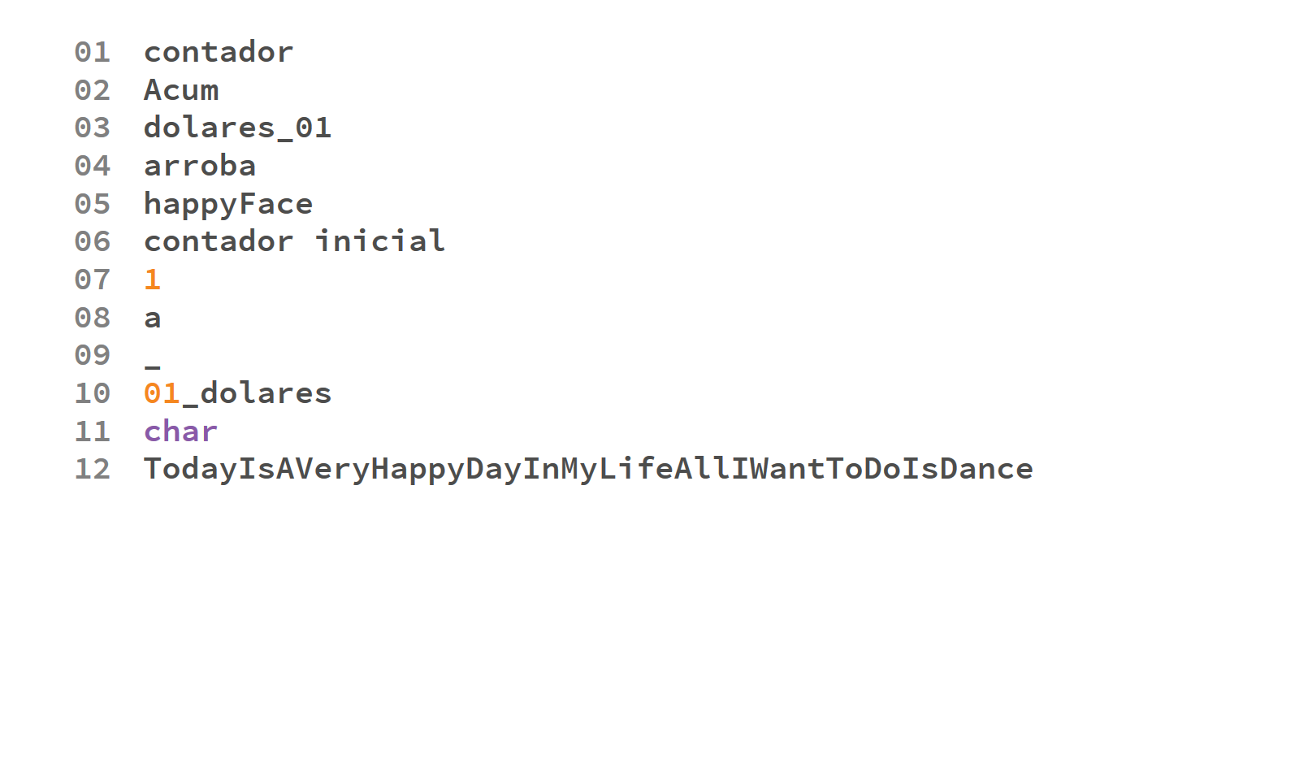

Slide 5
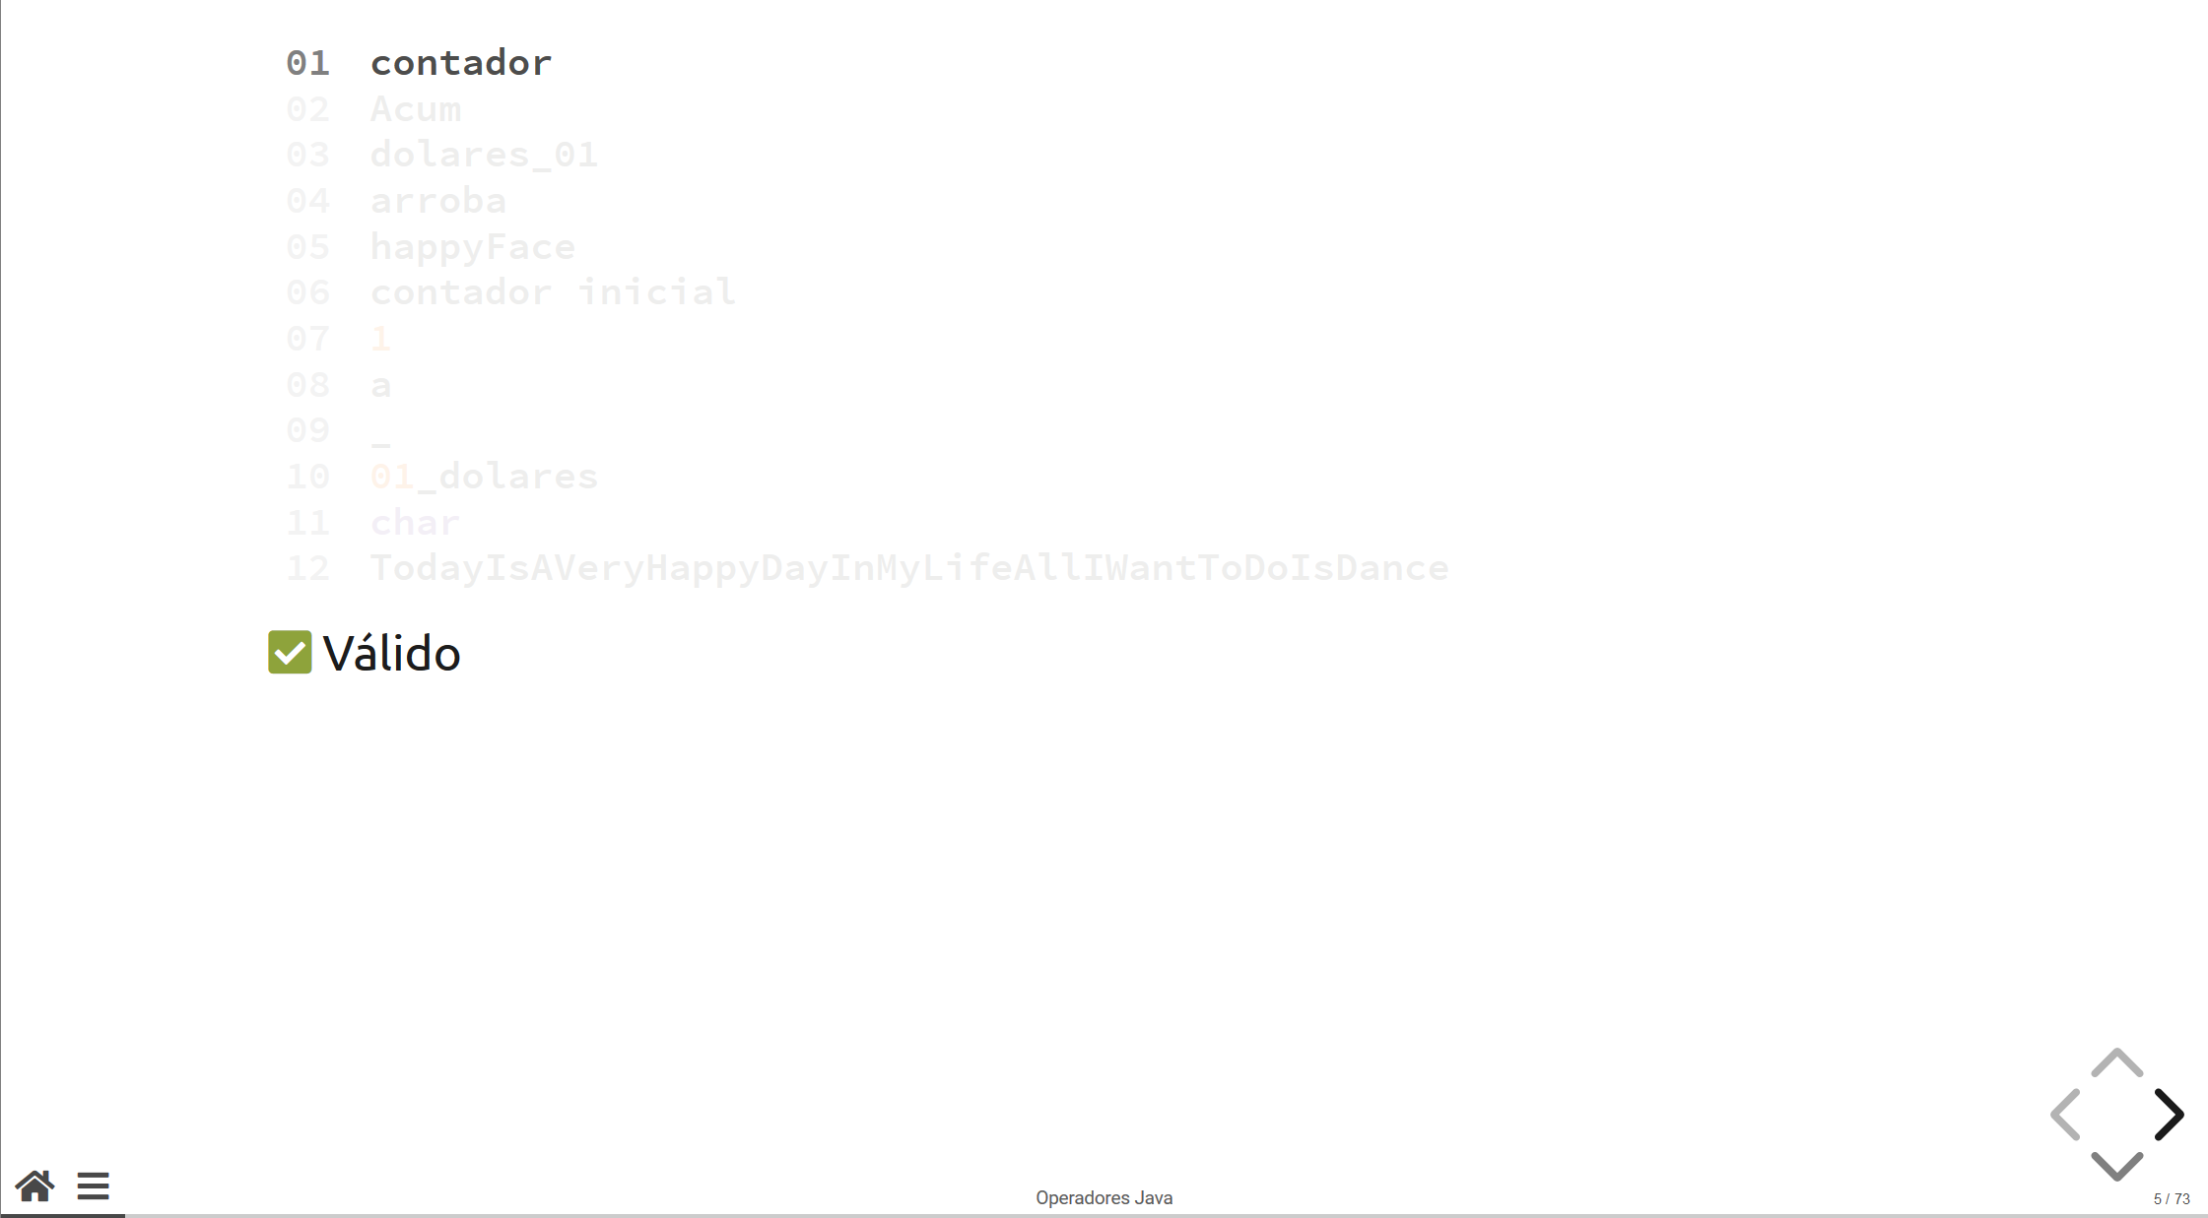
Valid

Slide 6
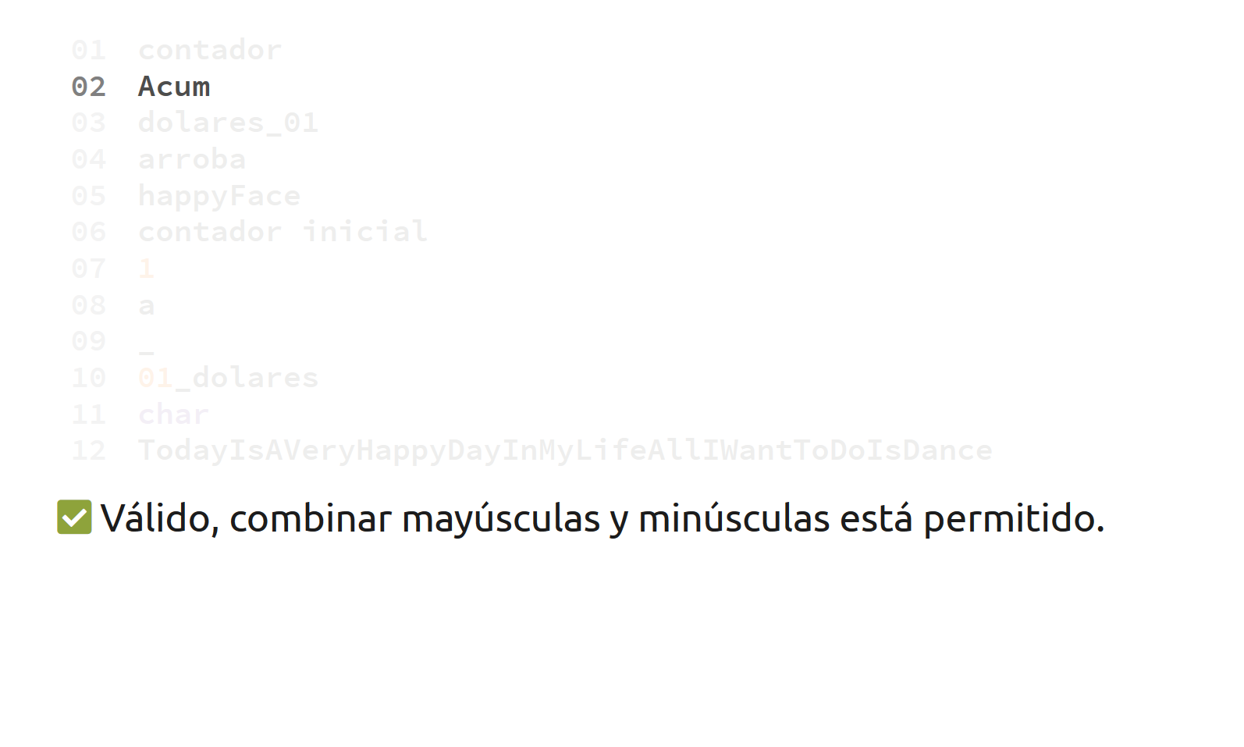
Valid, combining upper and lowercase is allowed

Slide 7
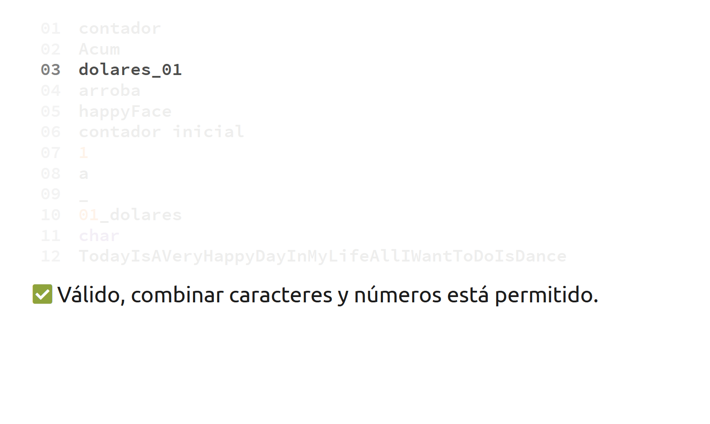
Valid, combining underscores, letters and numbers is permitted

Slide 8
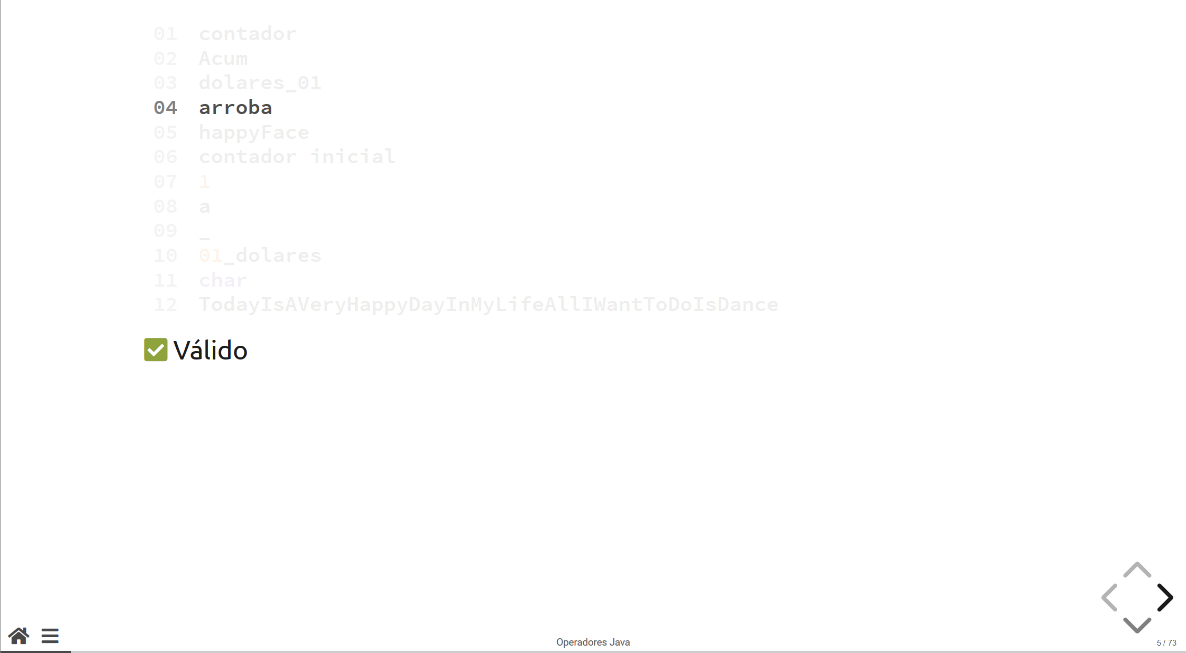
Valid

Slide 9
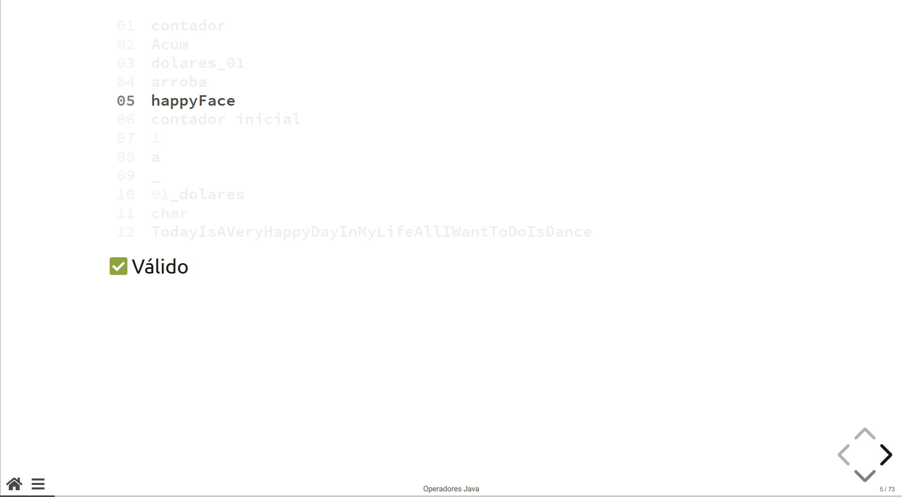
Valid

Slide 10
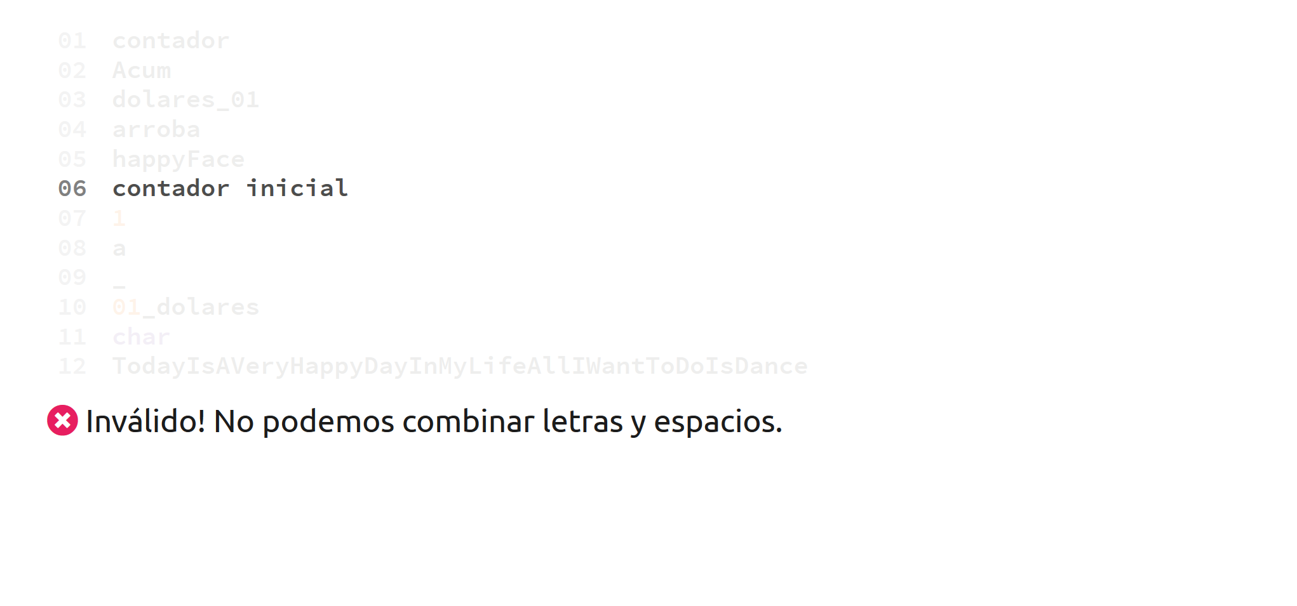
Invalid! Whitespaces cannot be part of an identifier

Slide 11
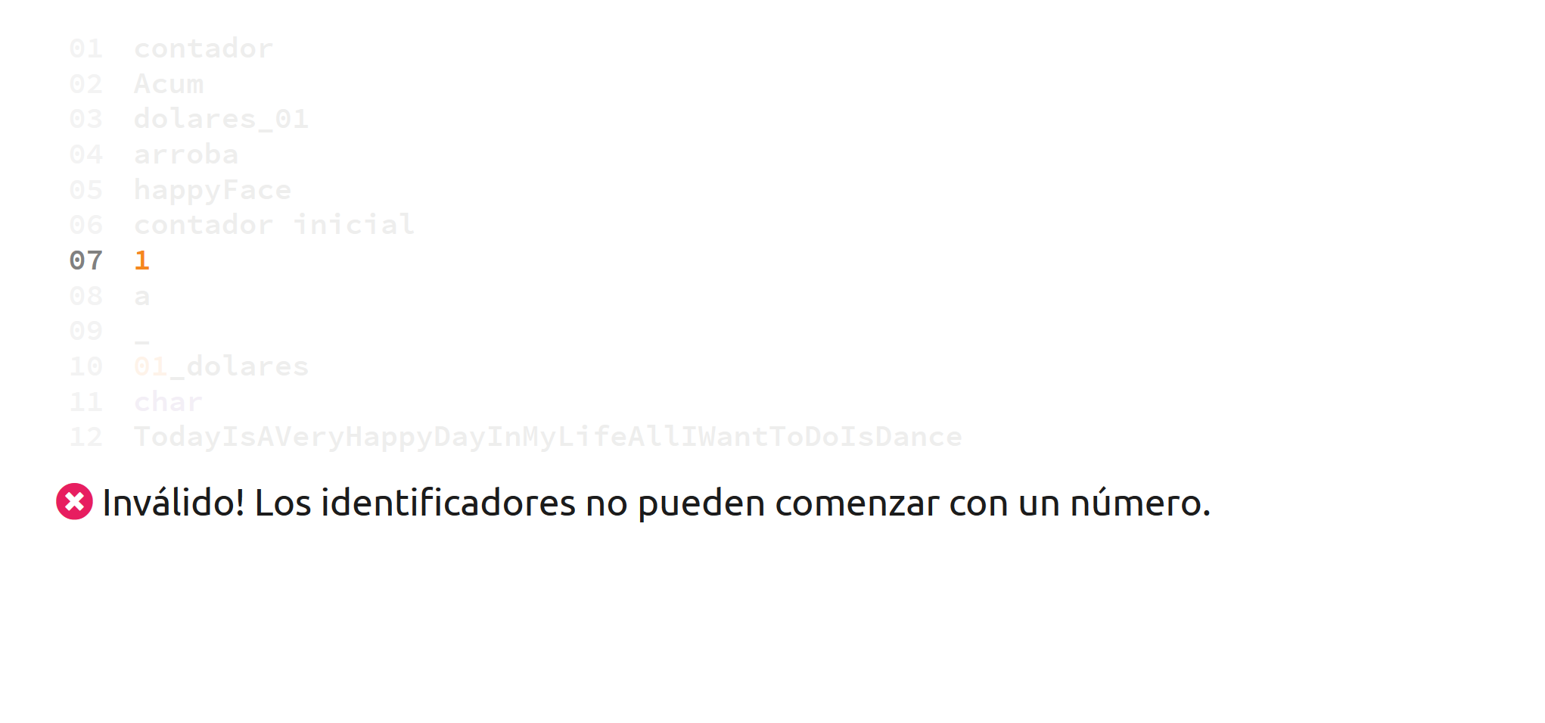
Invalid! A number by itself is not a valid identifier

Slide 12
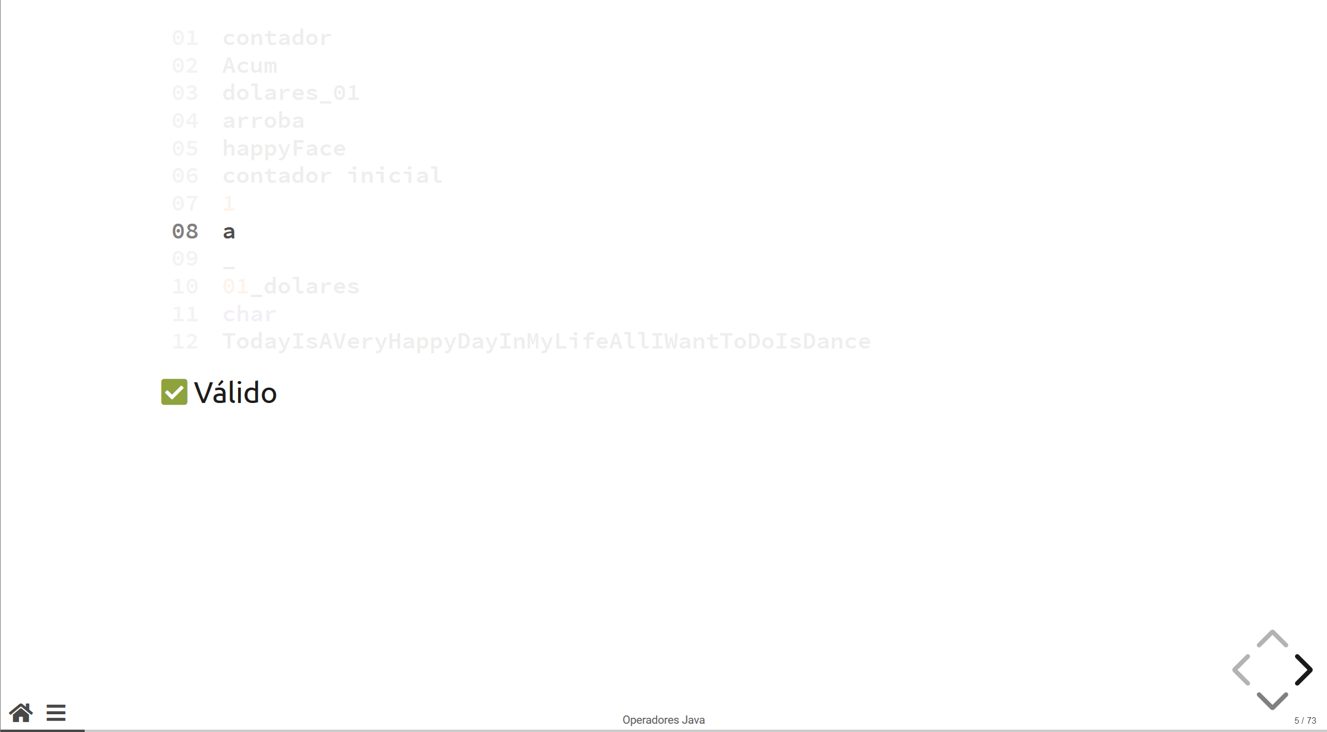
Valid

Slide 13
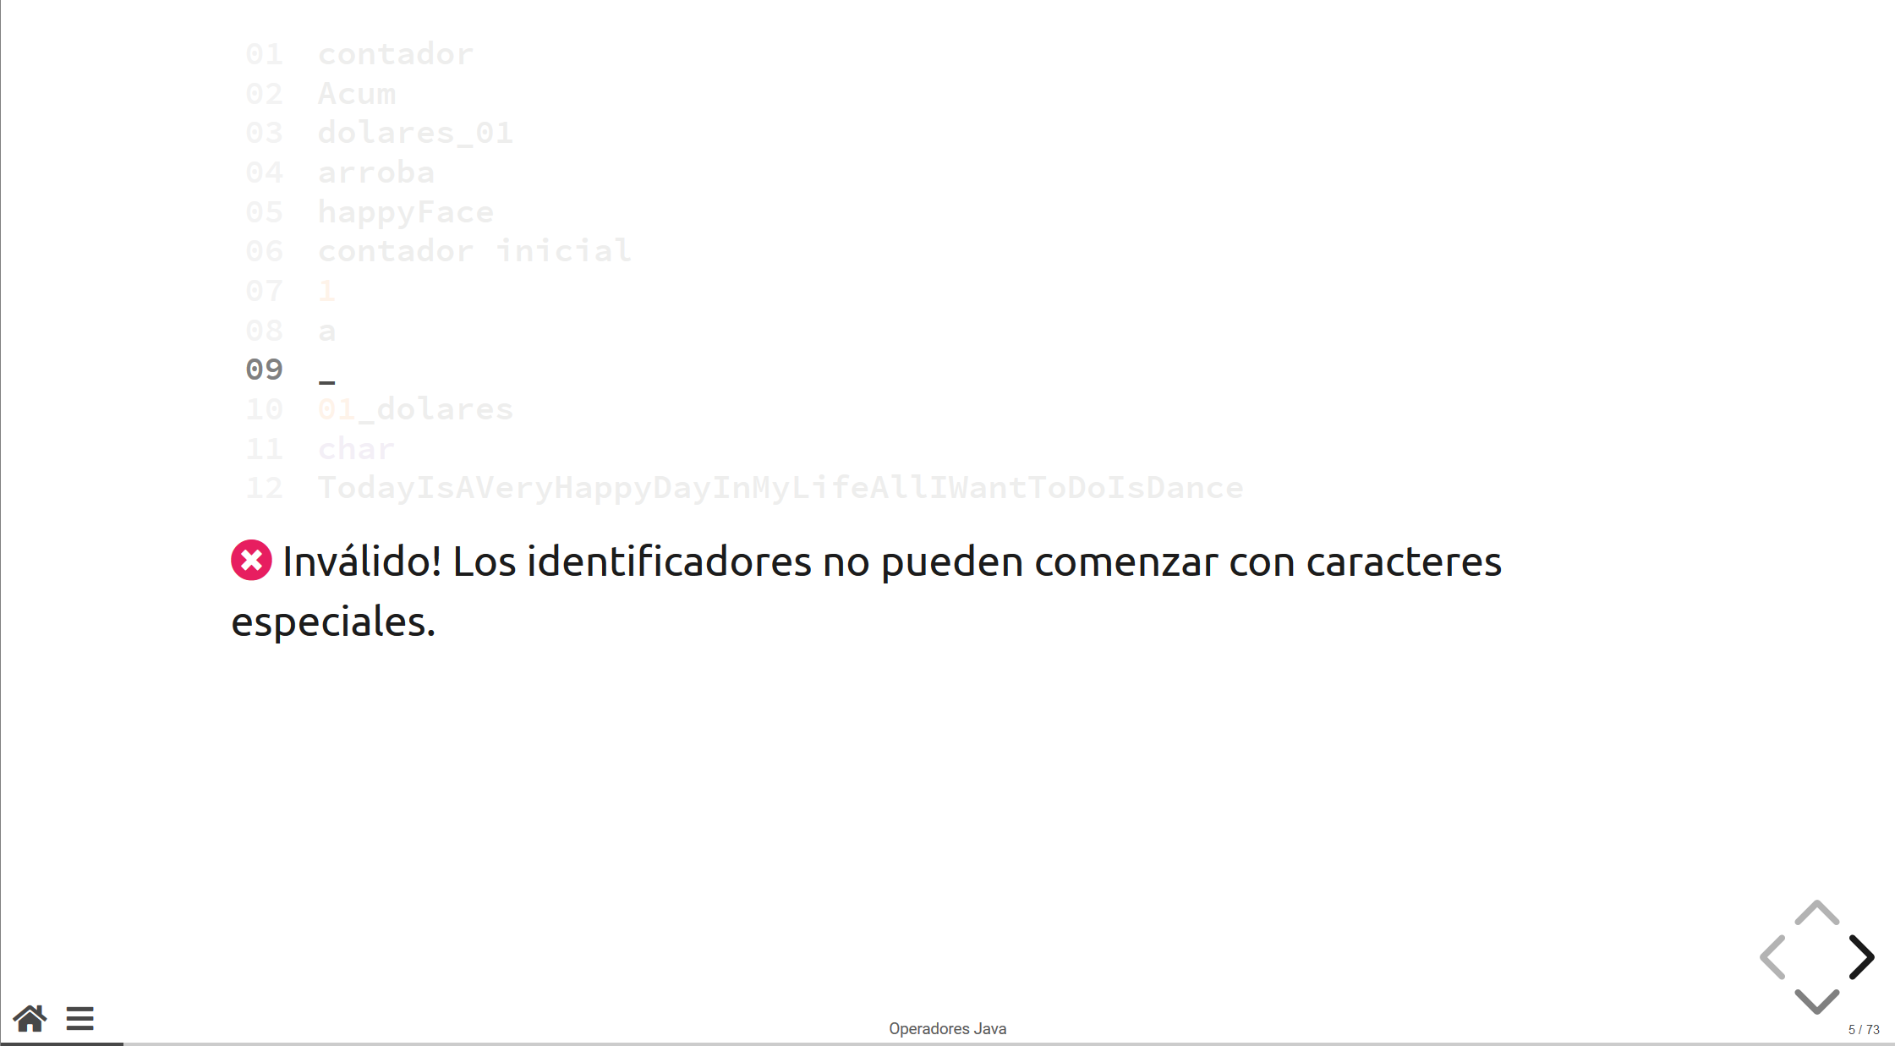

Invalid! A special character by itself is not a valid identifier

Slide 14
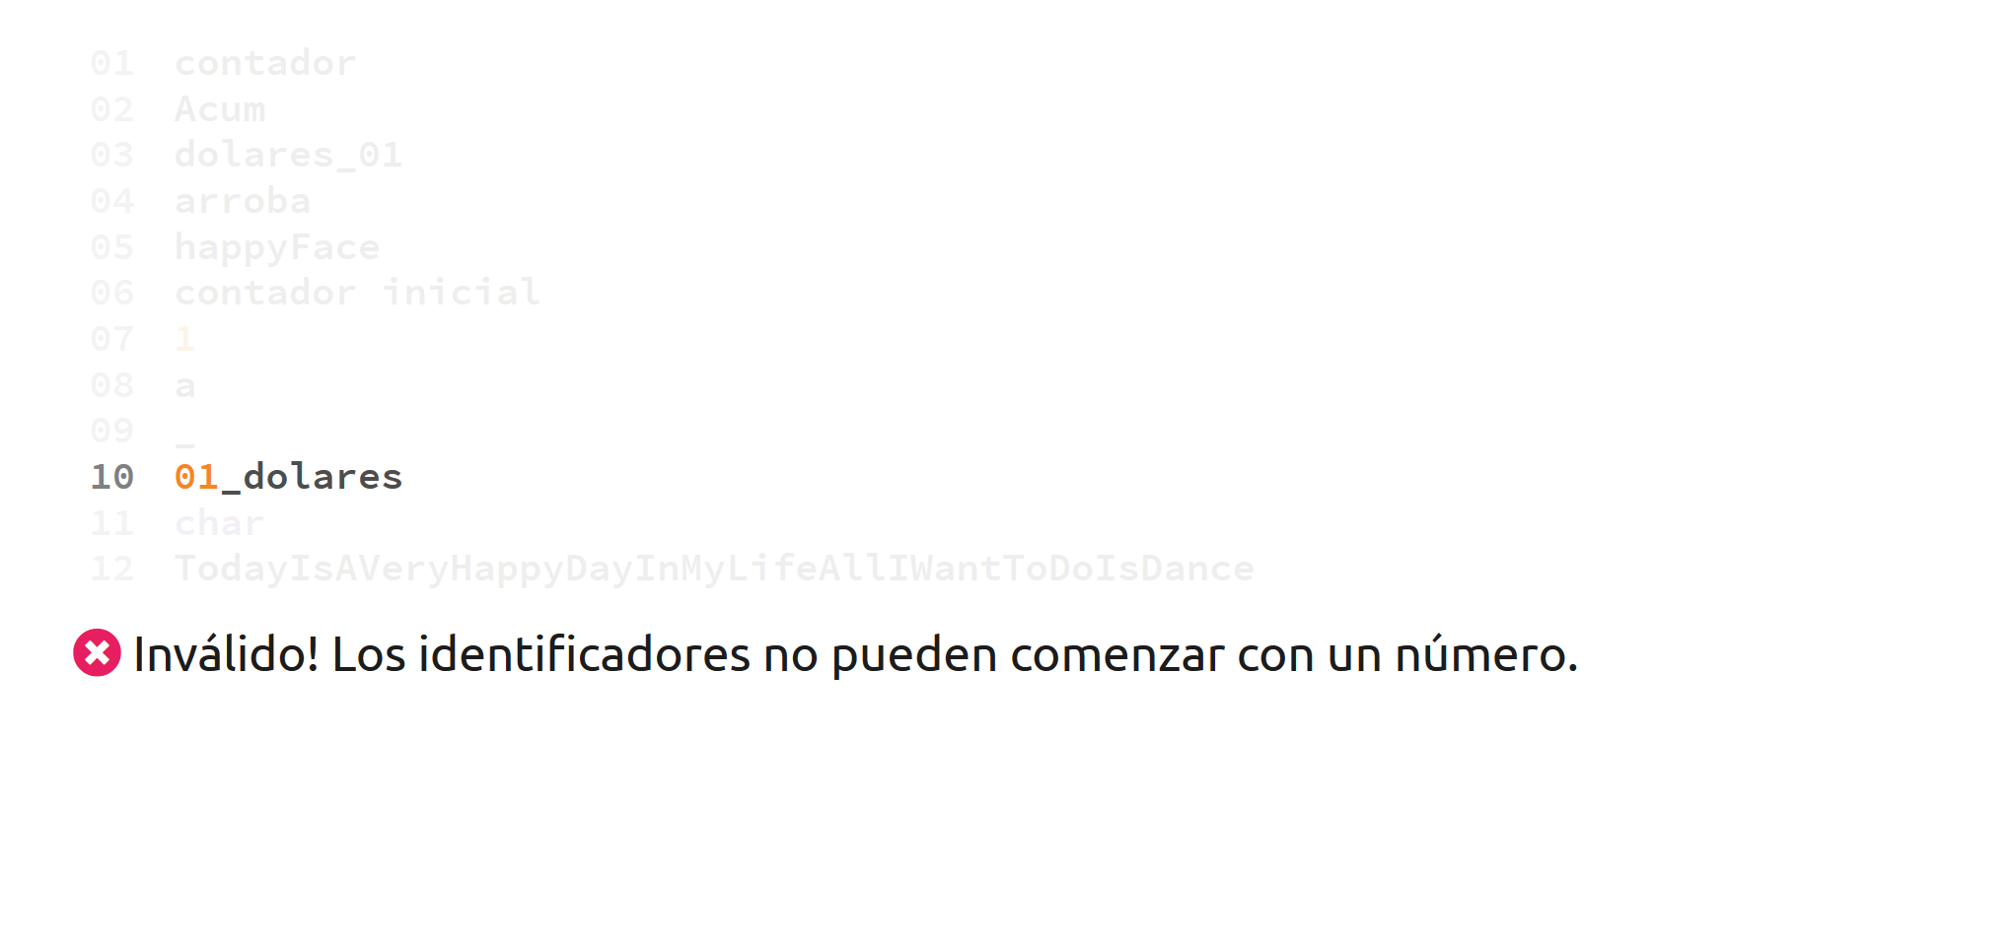
Invalid! Identifiers cannot start with a number

Slide 15
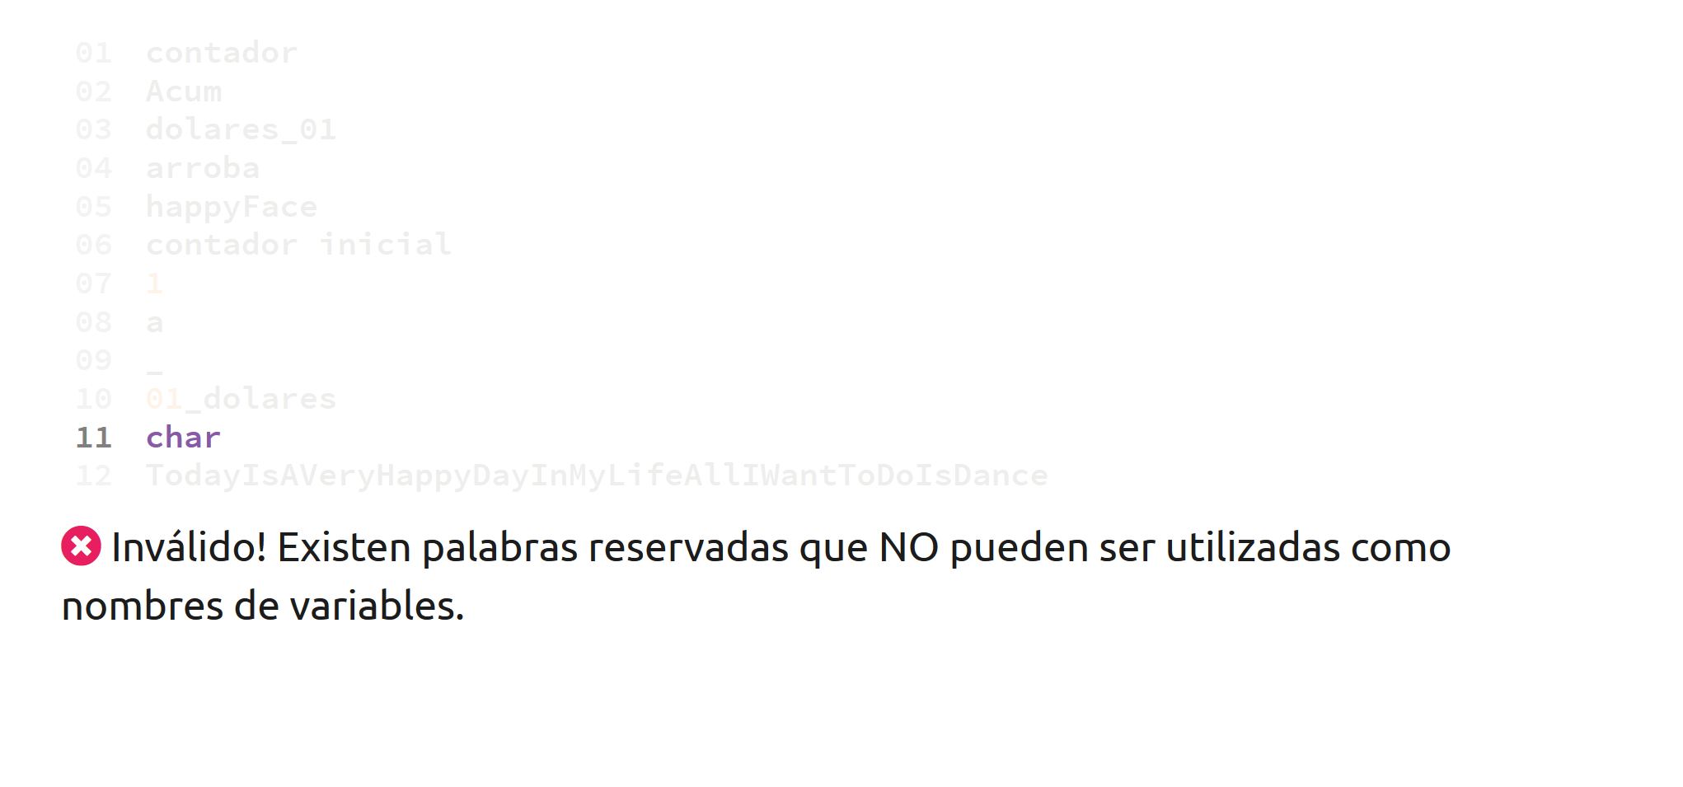
Invalid! Char is a reserved word in the Java programming language. Therefore, it cannot be used to name a variable.

Slide 16
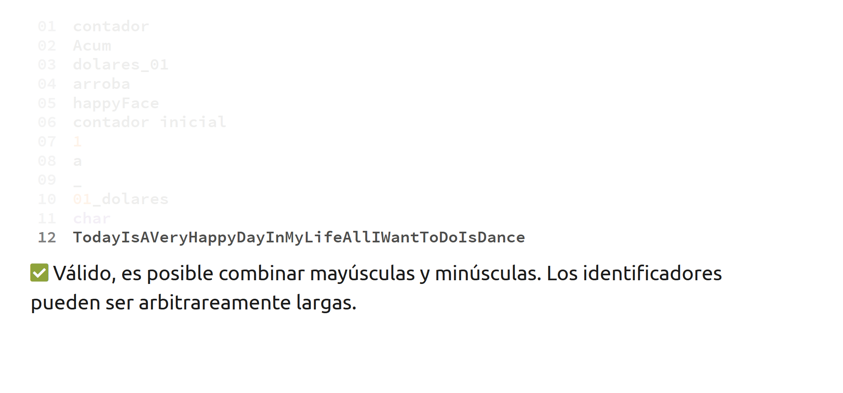
Valid! Identifiers can be as long as you want them to be.

Slide 17
Variables

Slide 18

Variables
A variable is the union of a data type and an identifier, and it allows us to store information. In Java, variables store information in RAM.

Slide 19
Variables
A variable goes through two phases:
Declaration: We specify a data type (int, char, String).
Assignment: We use the assign symbol (=) to assign a value.
A variable always has to be declared before it can be used.

Slide 20
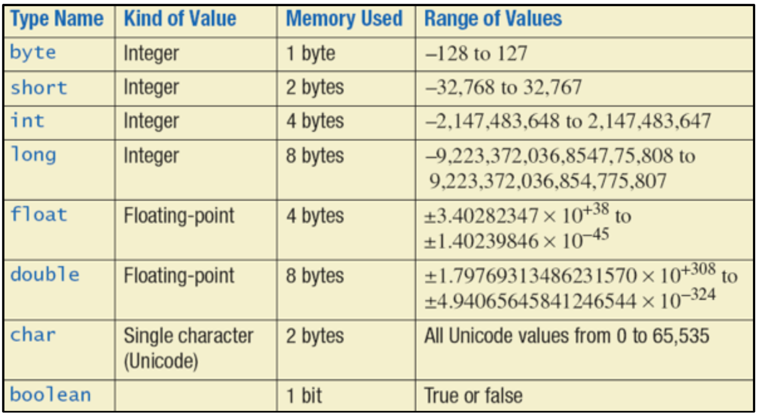

Slide 21


Primitive Data Types
Primitive data types are the most basic data types in Java. By combining this data types, we can represent any strucutre, game, video or object we can think of.

Slide 22
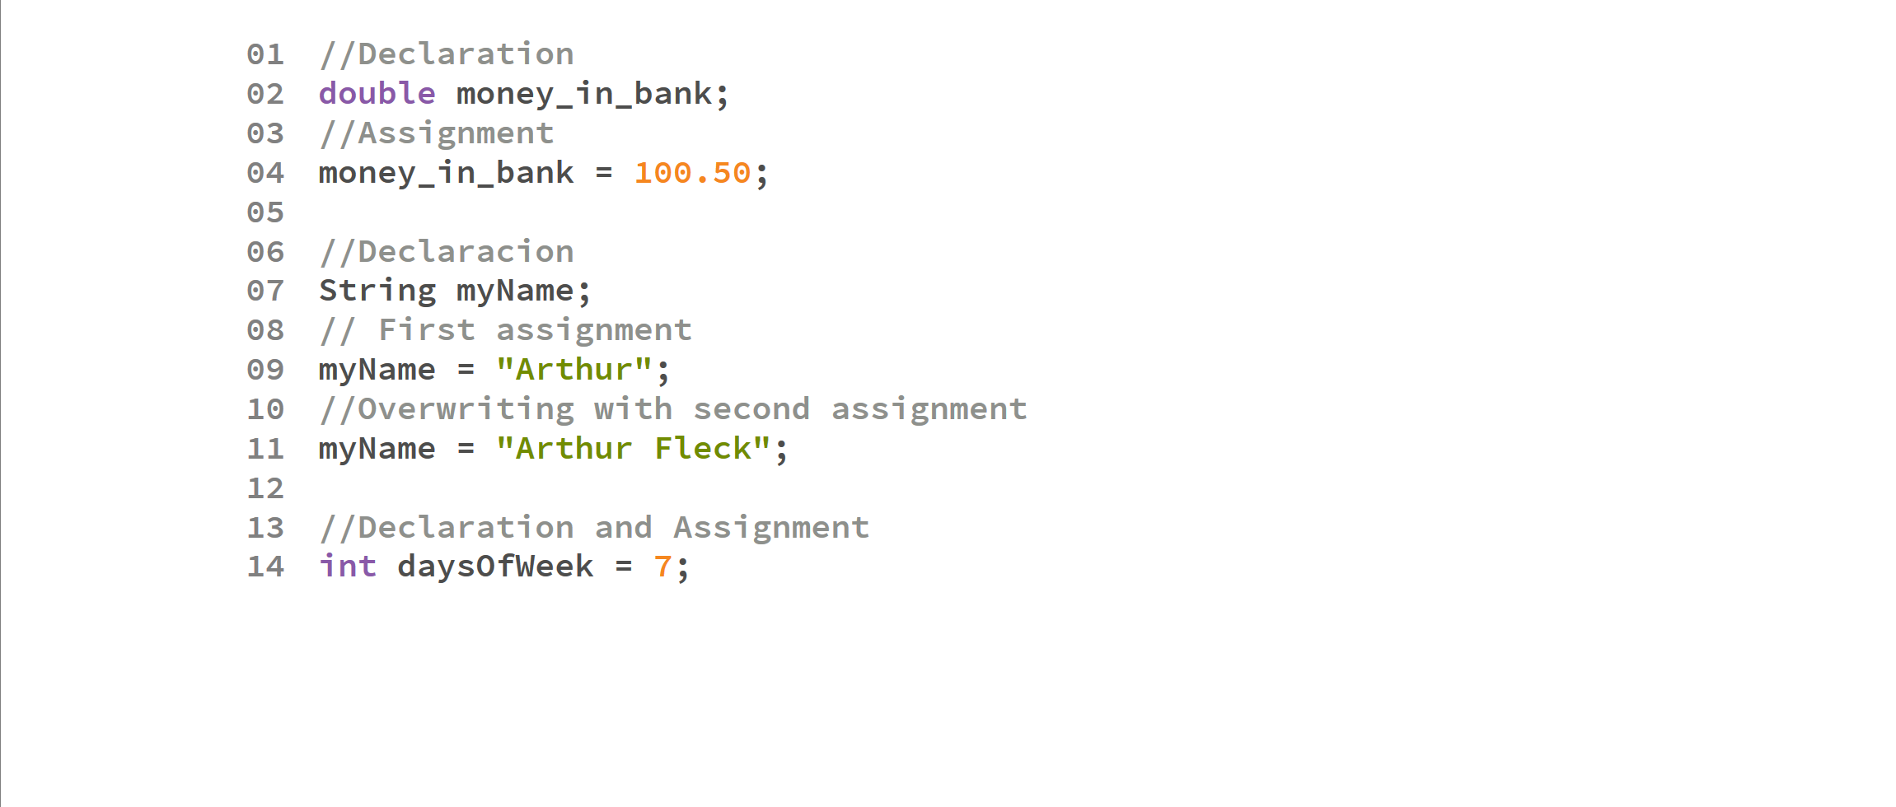

Slide 23
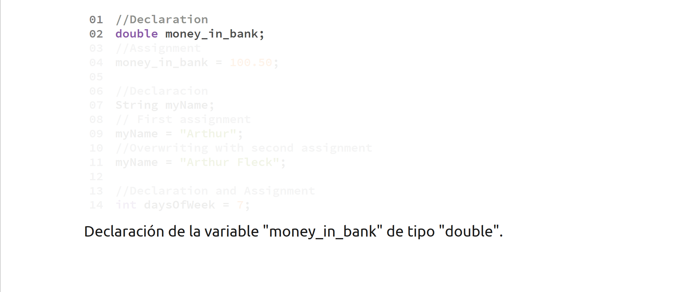
Variable money_in_bank is declared as a double

Slide 24
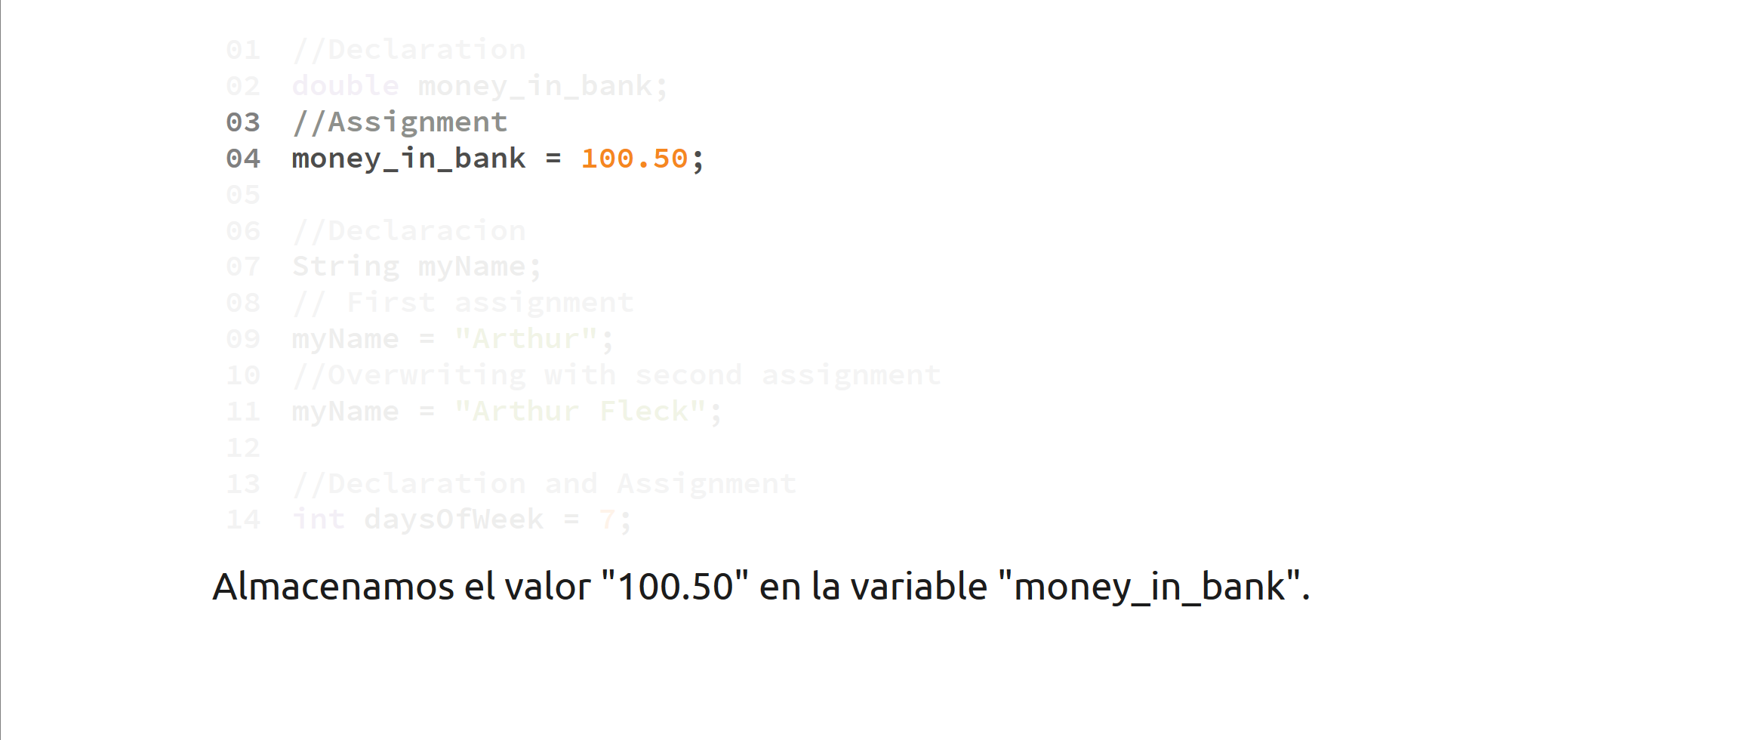
A value of 100.50 is assigned to a double variable

Slide 25
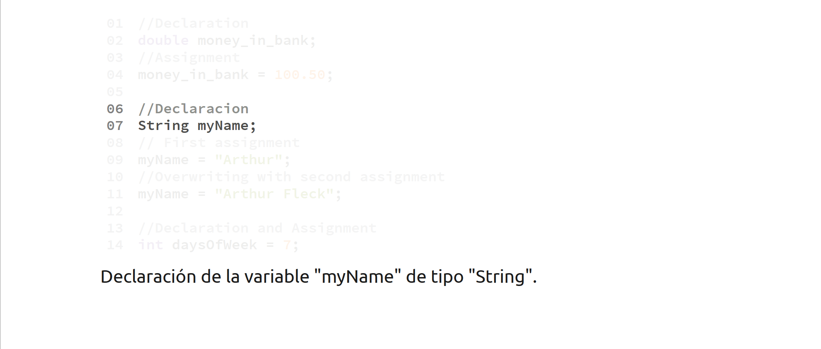
Variable myName is declared

Slide 26
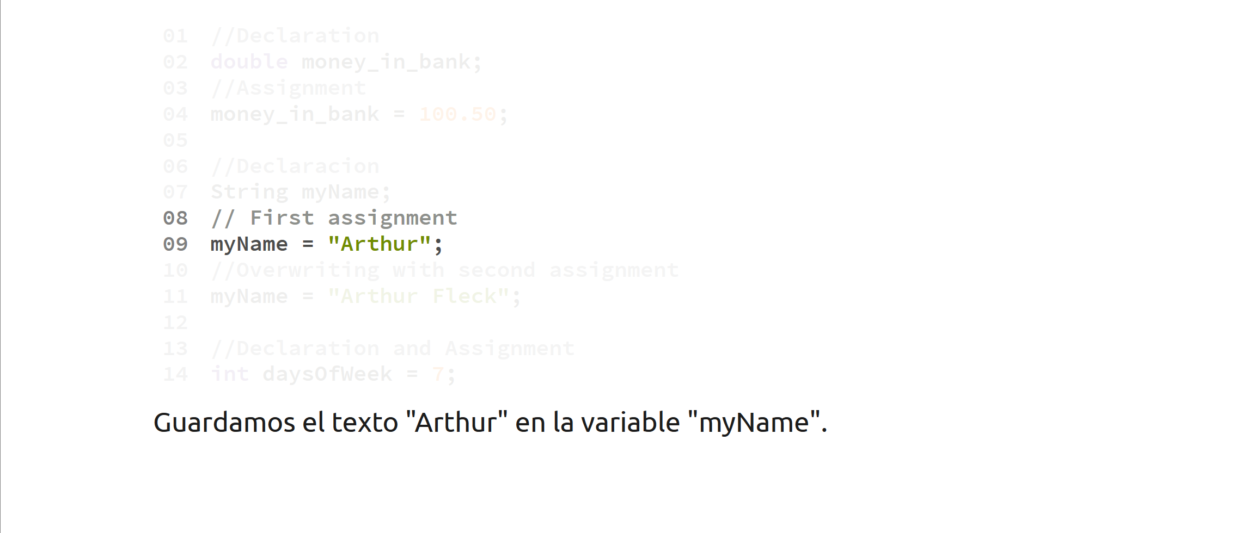
The text “Arthur” is stored on variable myName

Slide 27
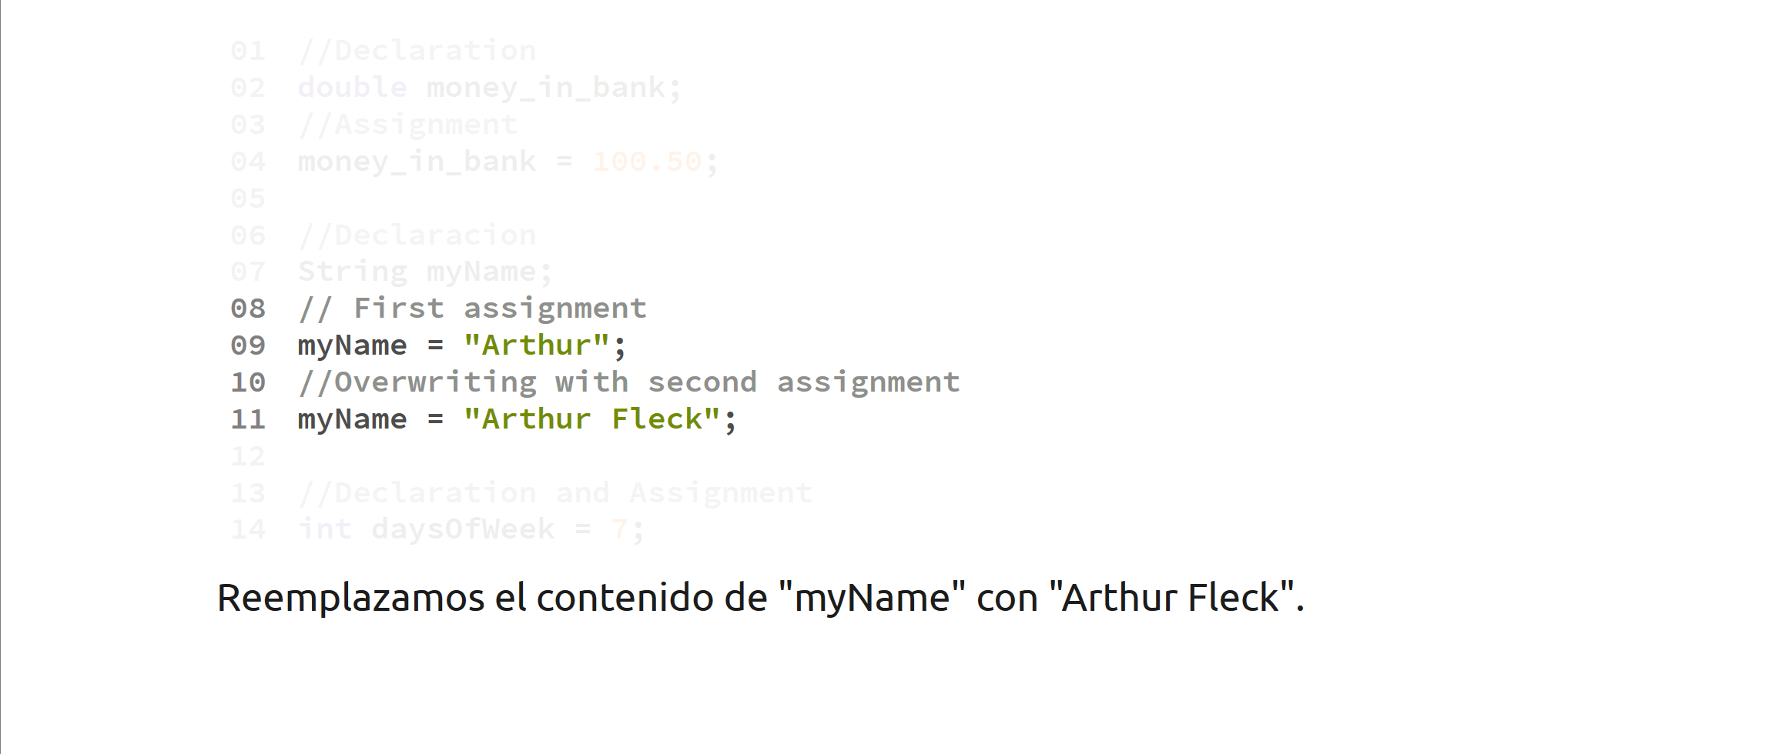
After the second assignment, the value in myName will be overwritten by “Arthur Fleck”

Slide 28
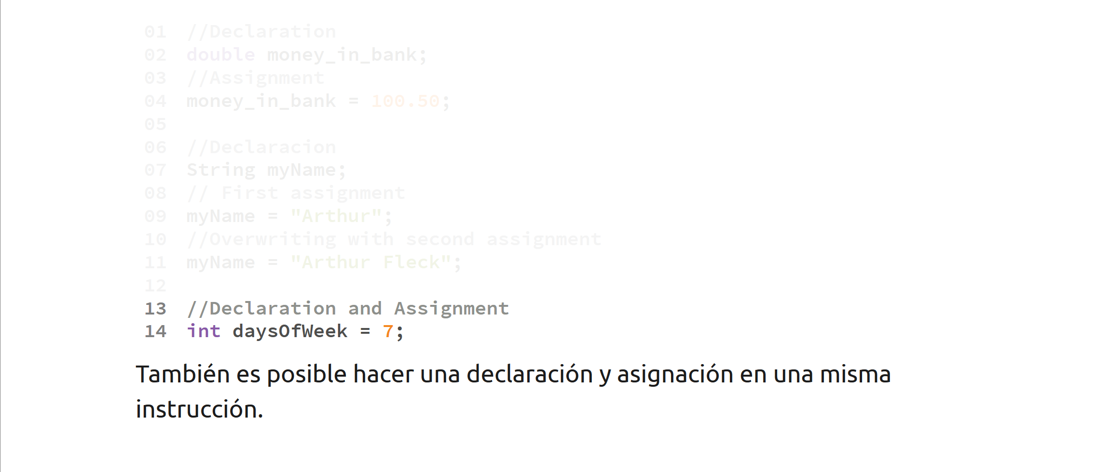
Declaring and assigning a variable is also possible a single instruction.

Slide 29
Operators

Slide 30
Arithmetic Operators
We can form arithmetic operations using the following symbols
Addition ( + )
Subtraction ( - )
Multiplication ( * )
Division ( / )
Module or remainder ( % )

Slide 31
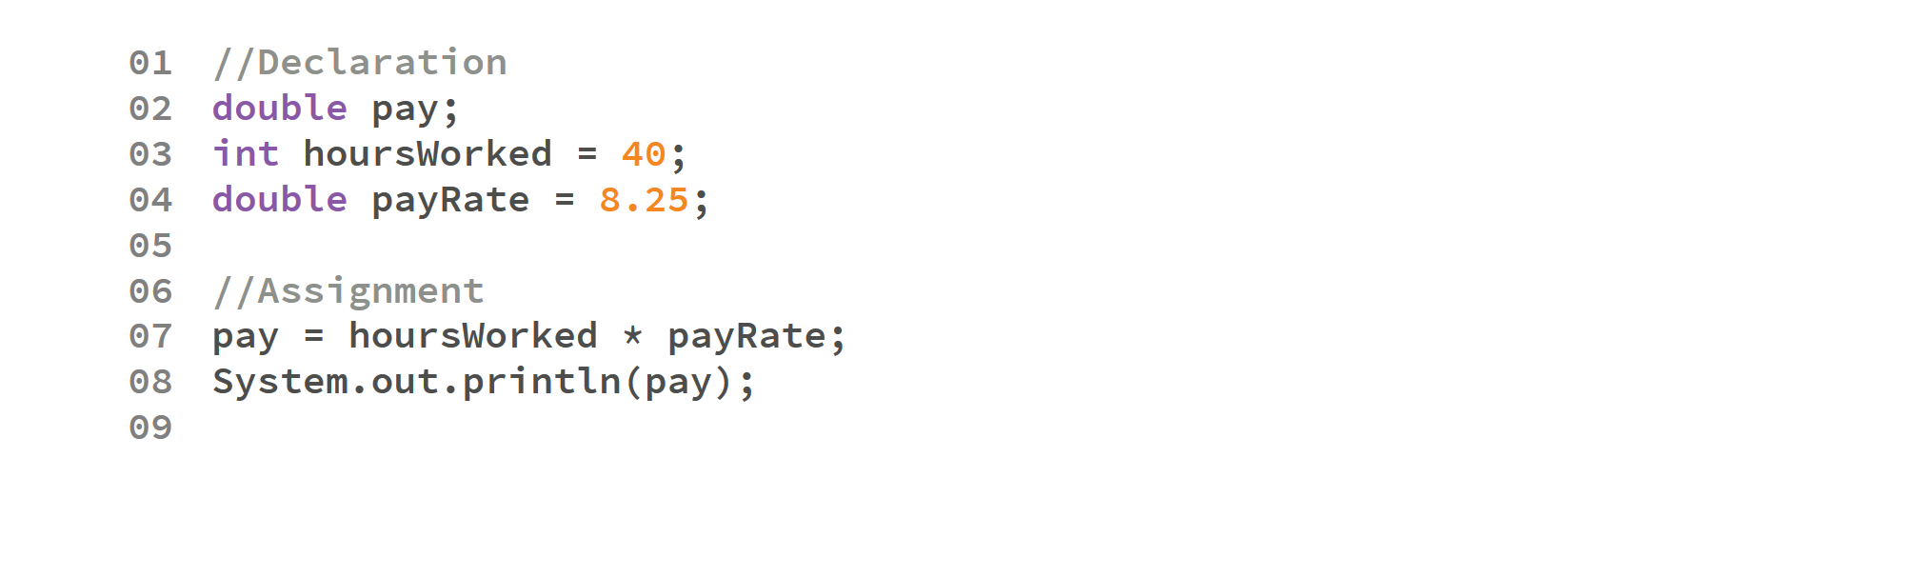
Output:
330.0

Slide 32

Output:
330.0
Initial declarations

Slide 33
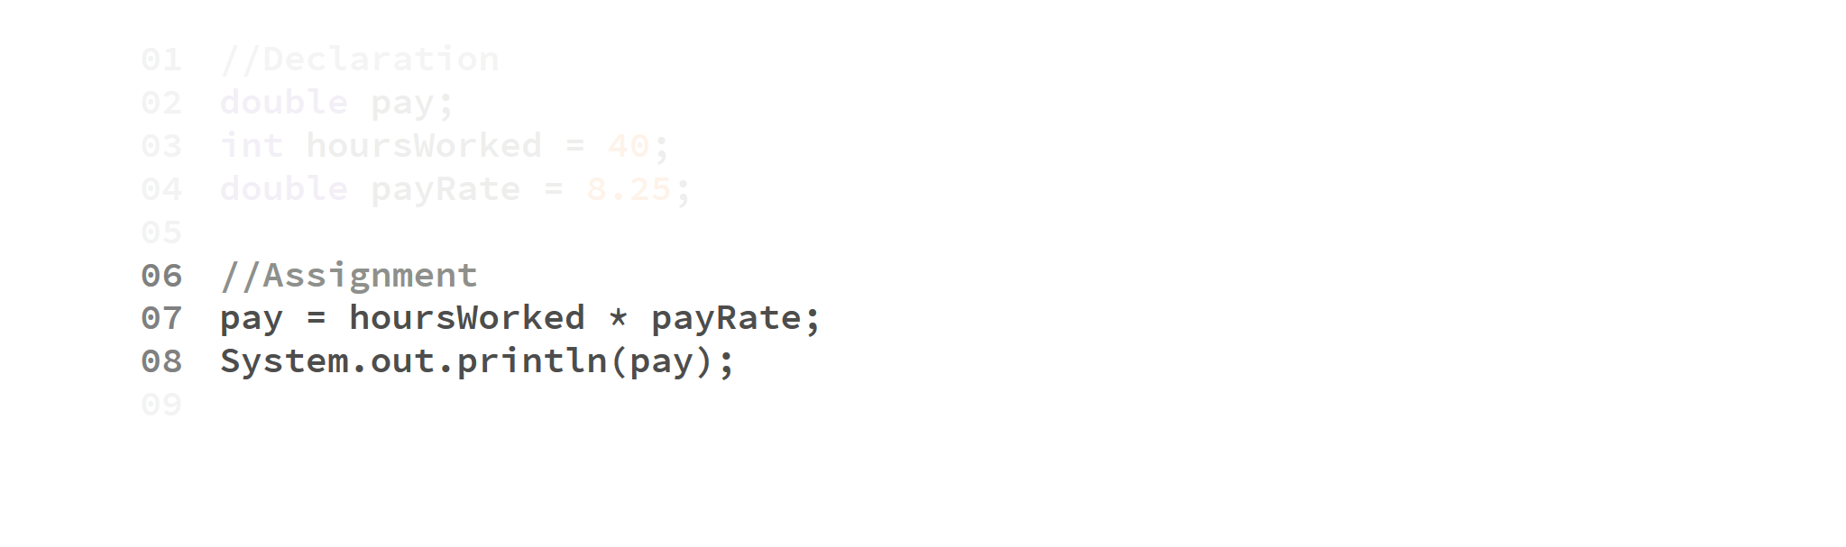
Output:
330.0
We multiply hoursWorked and payRate, assign the result to pay

Slide 34

Output:
330.0

Slide 35
Division
When we divide two integer variables (int), it is considered integer division. By that end, its result will be truncated:
int a = 9;
int b = 2;
int result = a / b;
System.out.println(result);
Output:
4

Slide 36
Even when the result is stored on a double variable.
int a = 100;
int b = 99;
double result = a / b;
System.out.println(result);
Output:
1.0

Slide 37


This can be fixed by changing at least one operand to a double.
double a = 3;
int b = 2;
double result = a / b;
System.out.println(result);
int a = 3;
int b = 2;
double result = a / b;
System.out.println(result);
Output:
1.5
Output:
1.0
double a = 3;
double b = 2;
double result = a / b;
System.out.println(result);
double result = 3.0 / 2.0;
System.out.println(result);
Output:
1.5
Output:
1.5

Slide 38
Operator Precedence
Operator precedence specifies the way operands are grouped:
For example,
1 + 2 * 3 is treated as 1 + (2 * 3)
1 * 2 + 3 is treated as (1 * 2) + 3
You can use parentheses to override the default operator precedence rules.

Slide 39
Operator Associativity
When an expression has two operators with the same precedence, the operators and operands are grouped according to their associativity.
For example:
72 / 2 / 3 is treated as (72 / 2) / 3 since the division operator is left-to-right associate.
You can use parentheses to override the default operator associativity rules.

Slide 40
Order of operations
Most Java operators are left-to-right associative.
As a result, the expression
x = 3*5+4/2*3
Will be 21
The one notable exception is the assignment operator, which is right-to-left associative.

Slide 41
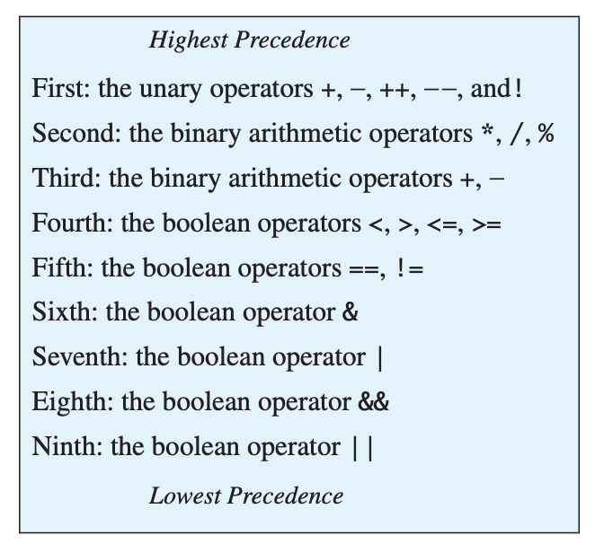

Slide 42
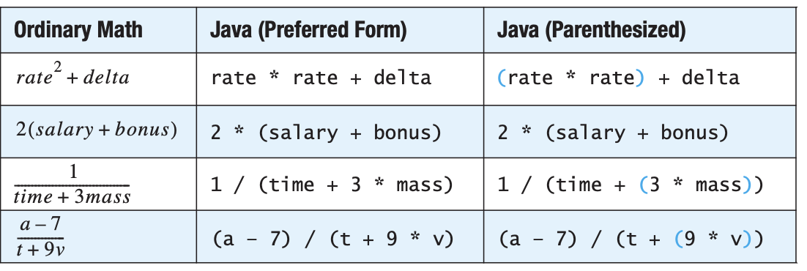

Slide 43
Scanner class
Reading from the console

Slide 44
Scanner class
The Scanner class is a library with instructions that allow programs to read information from the keyboard.
To use a library, we first need to import it to our project. We use the import instruction for that.
import java.util.Scanner;

Slide 45
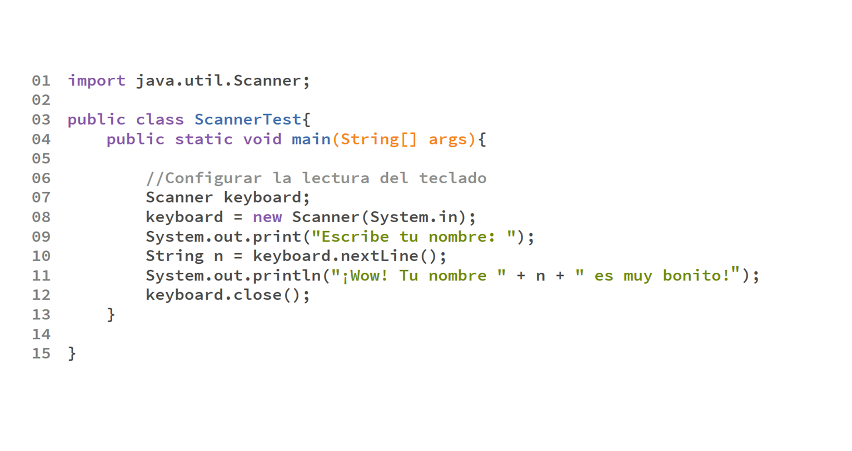

Slide 46
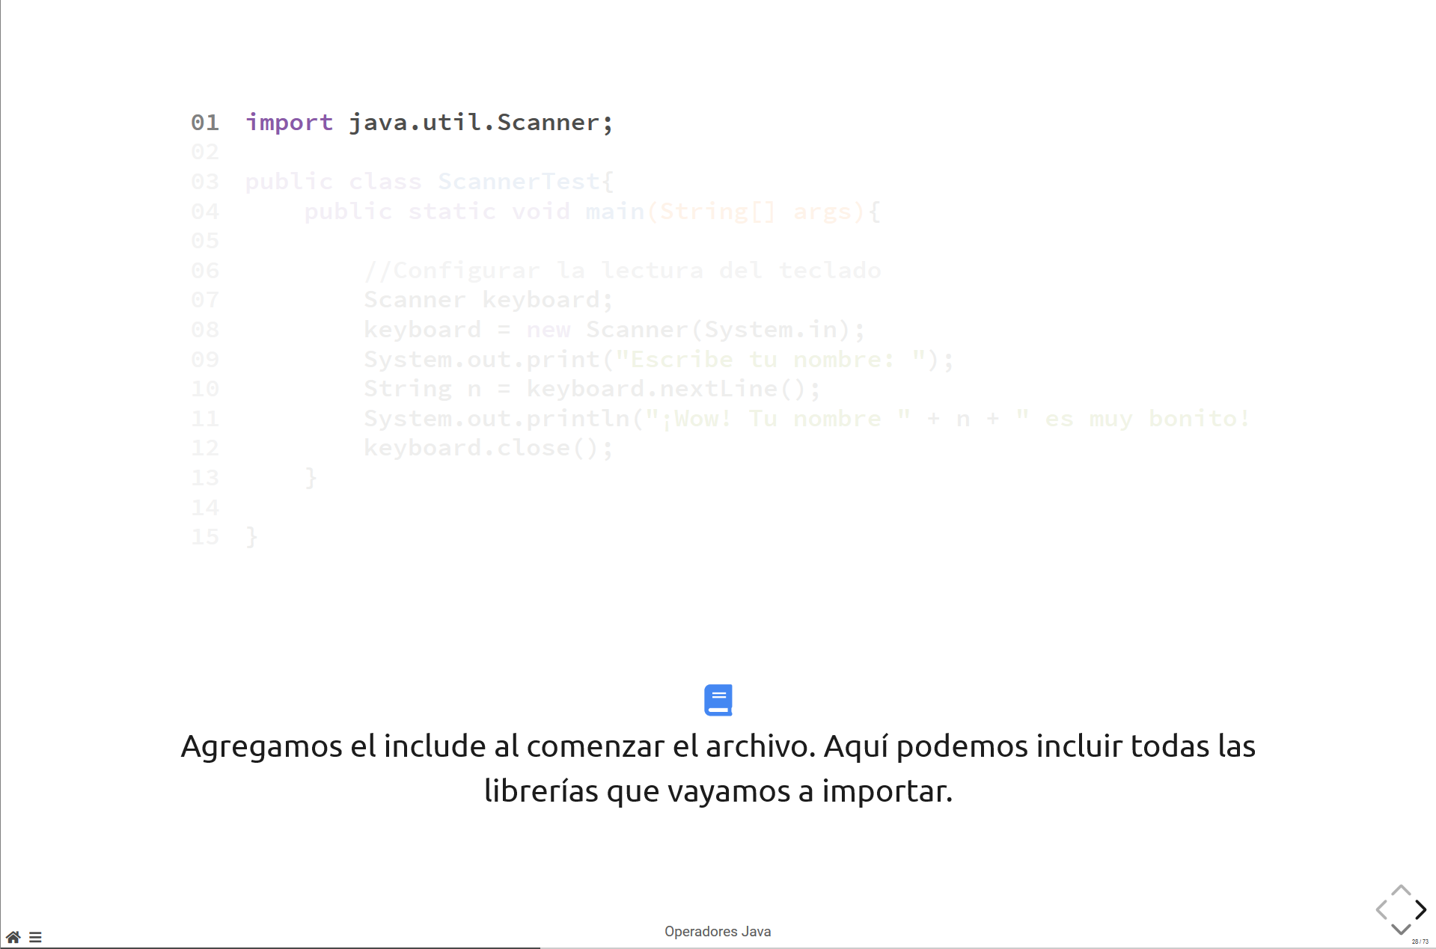
Import Scanner class into the project

Slide 47
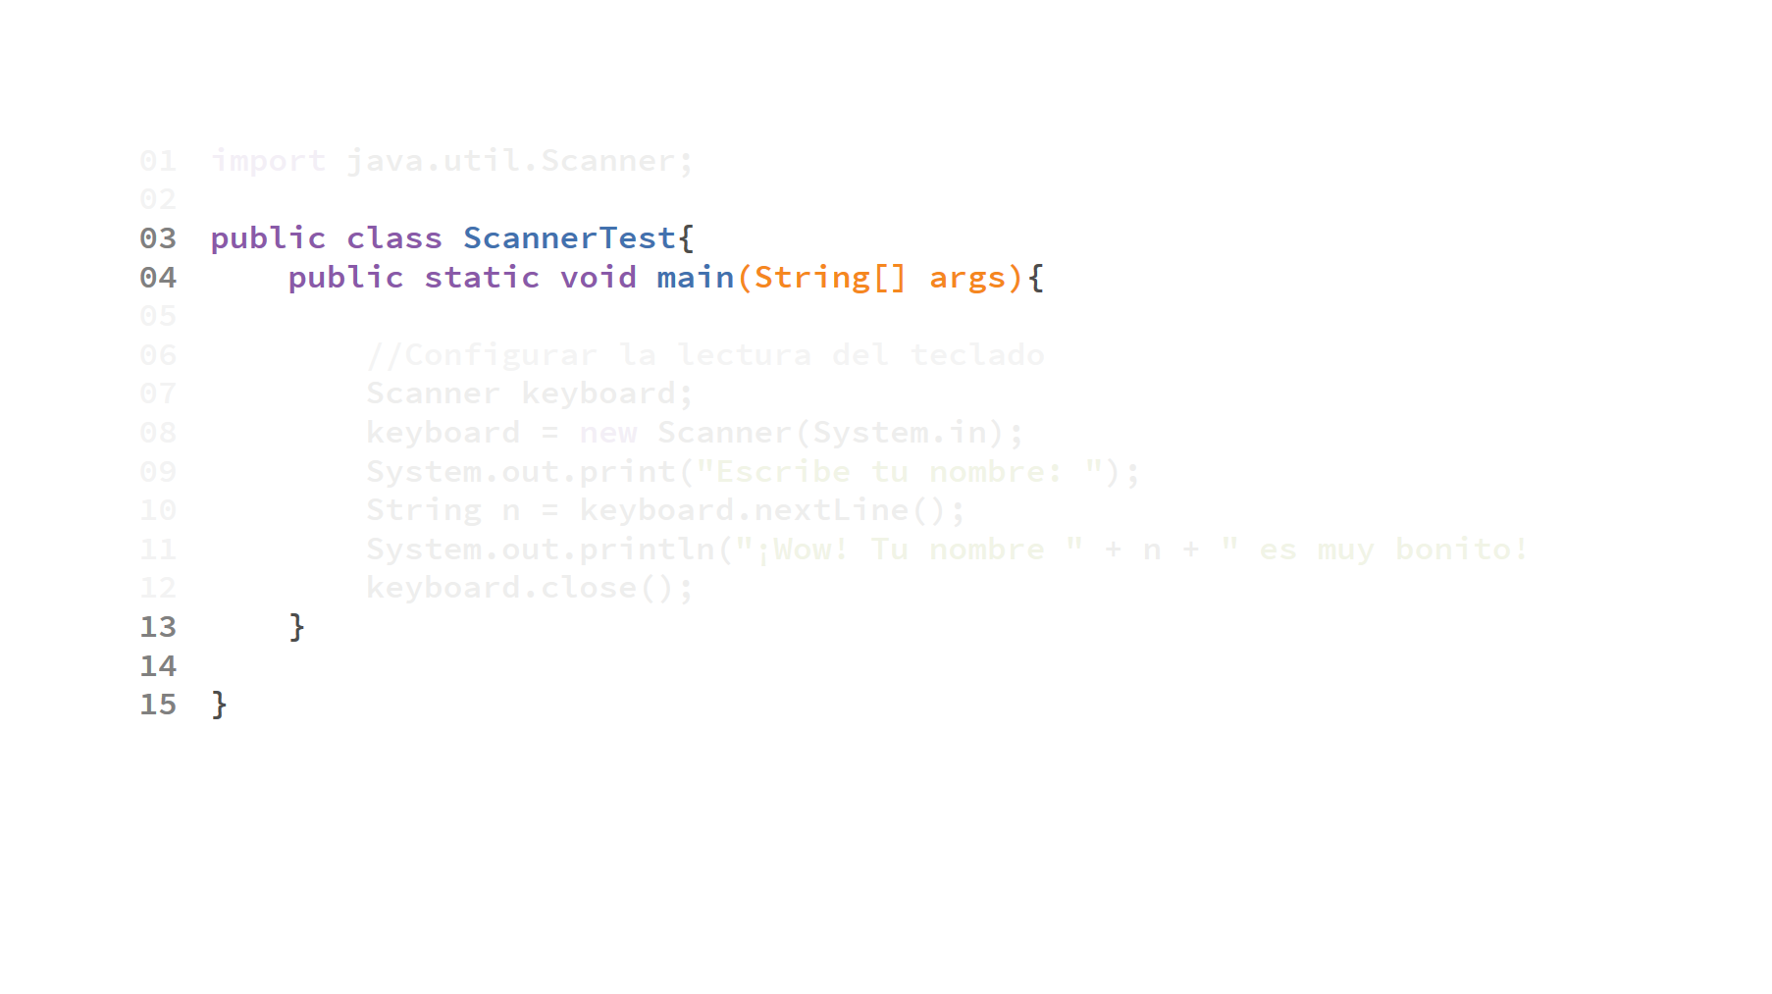
Main declaration

Slide 48
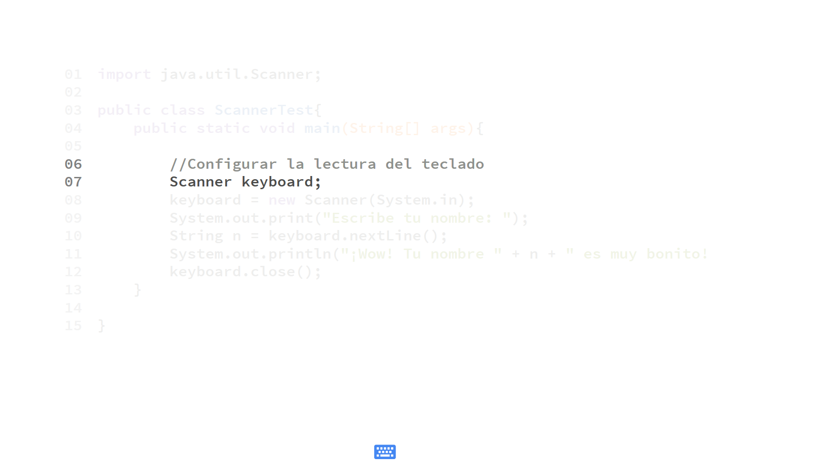
We declare a Scanner variable called keyboard

Slide 49
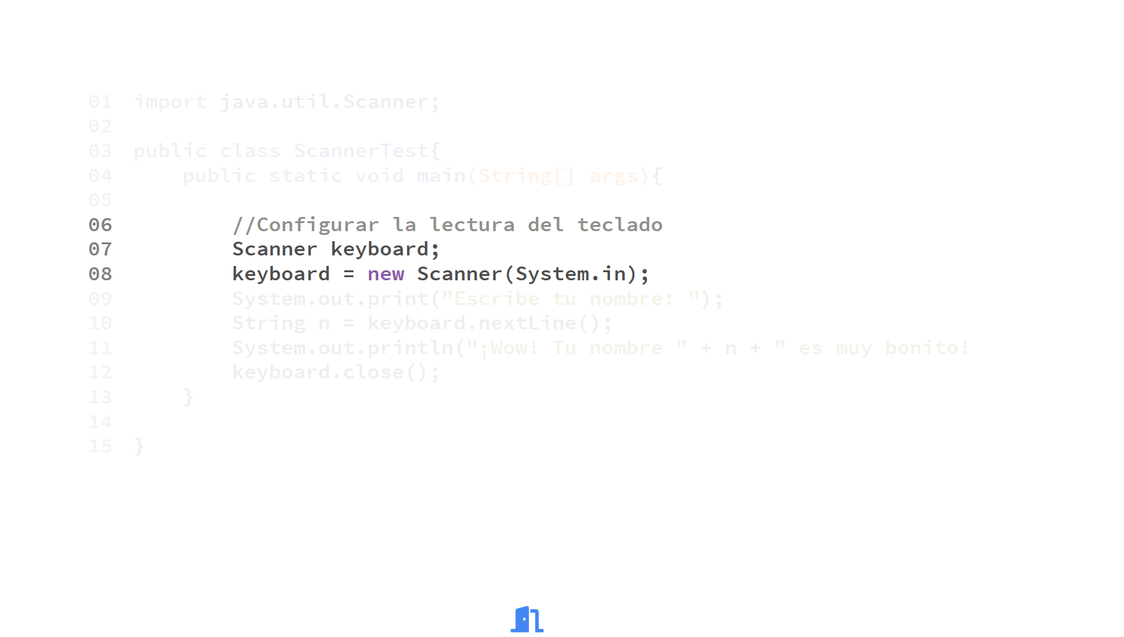
We initialize the keyboard variable

Slide 50
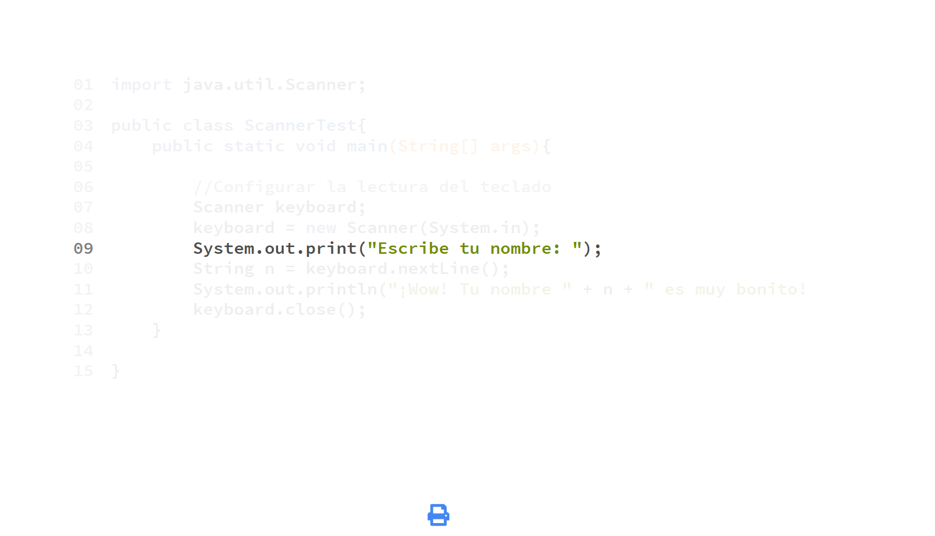

Slide 51
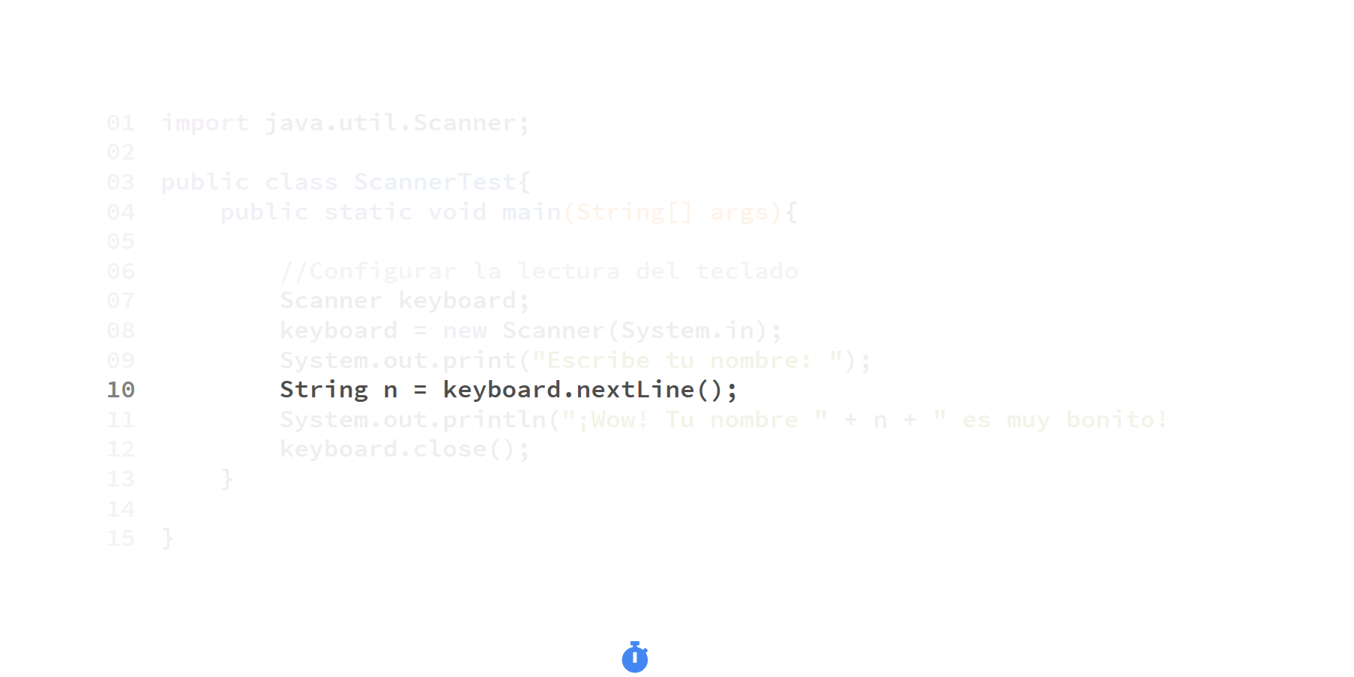
The program will stop until something is typed on the keyboard

Slide 52
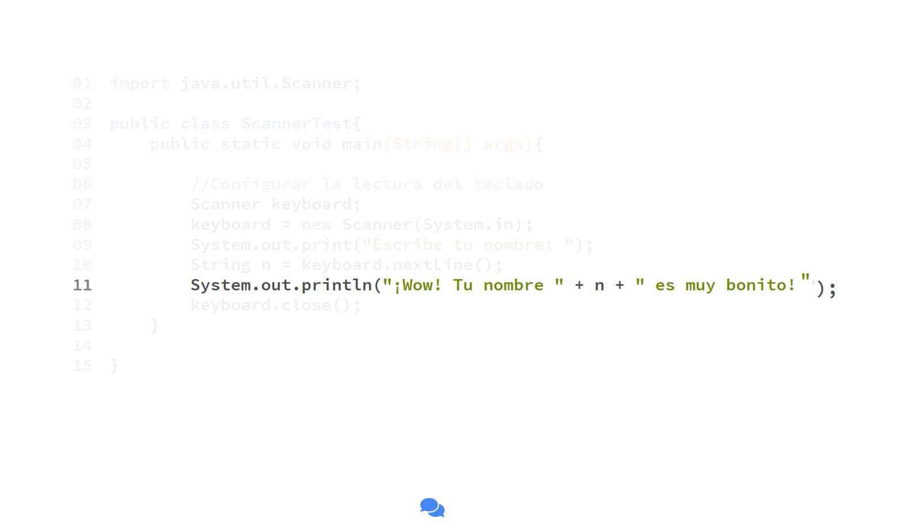
Print an output message

Slide 53
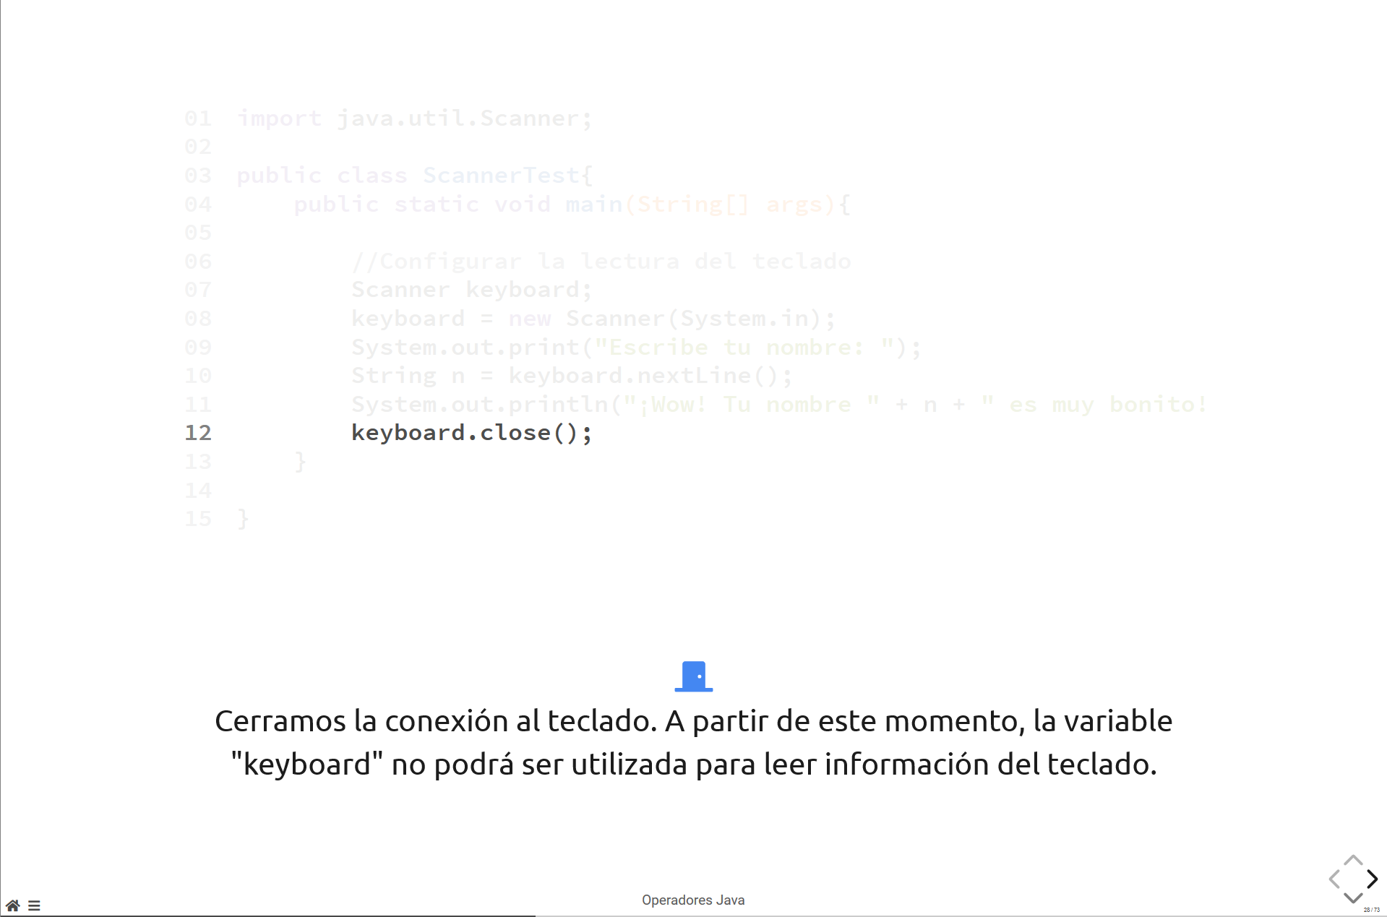
Close the keyboard variable. It will no longer be usable after this

Slide 55
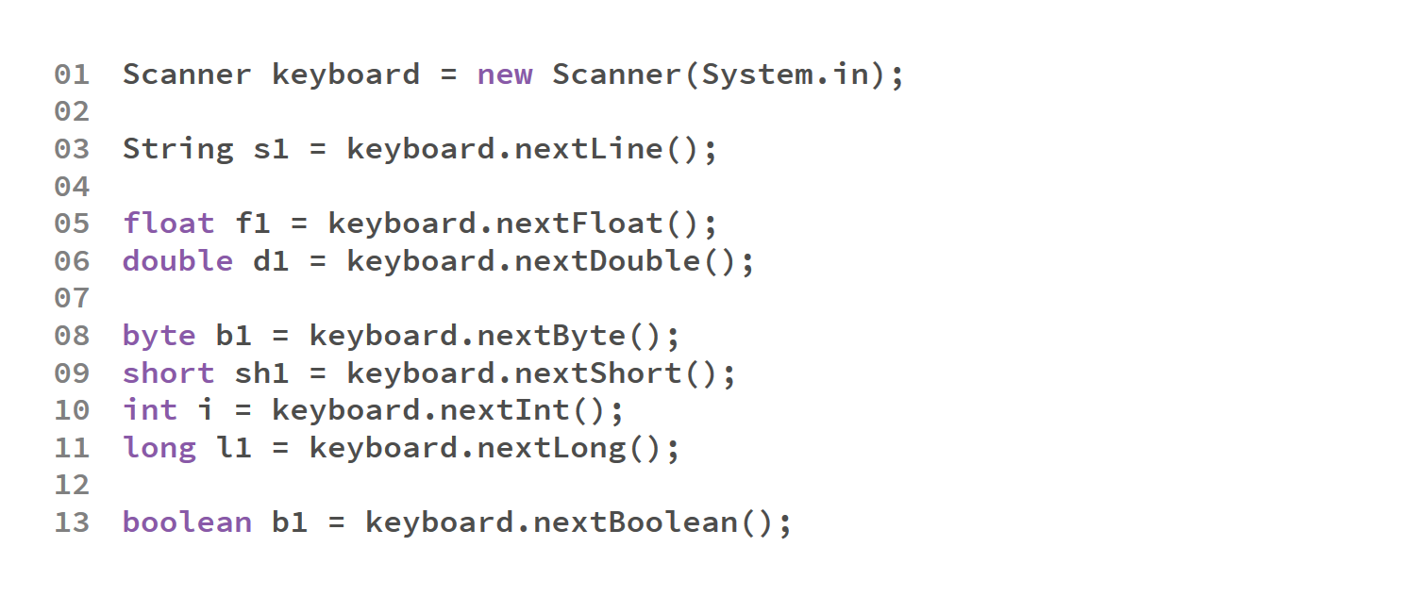

Slide 56
Incremental and Decremental Operators

Slide 57
Incremental and Decremental Operators
There are special instructions that let us increment or decrement the value of a variable by 1.
Operator | Use | Description | Name
++ | op++ | Evaluate and then increment | Postfix increment
++ | ++op | Increment, then evaluate | Prefix increment
-- | op-- | Evaluate, then decrement | Postfix decrement
-- | --op | Decrement, then evaluate | Prefix decrement

Slide 58
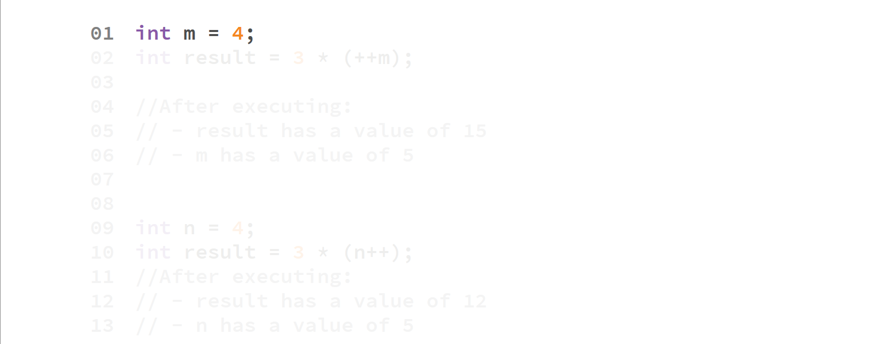
“m” is assigned a value of 4

Slide 59
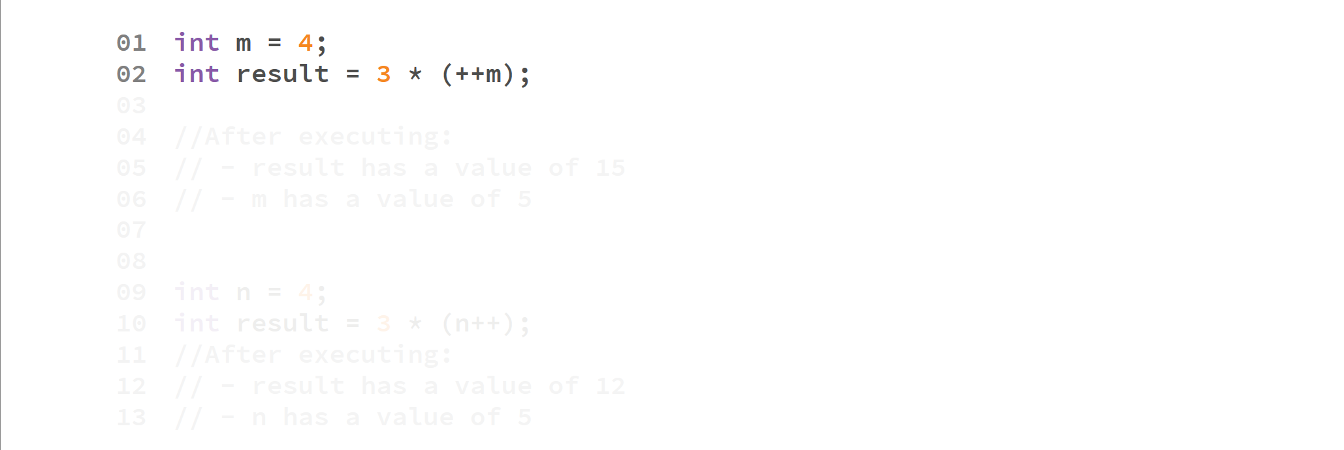

Slide 60
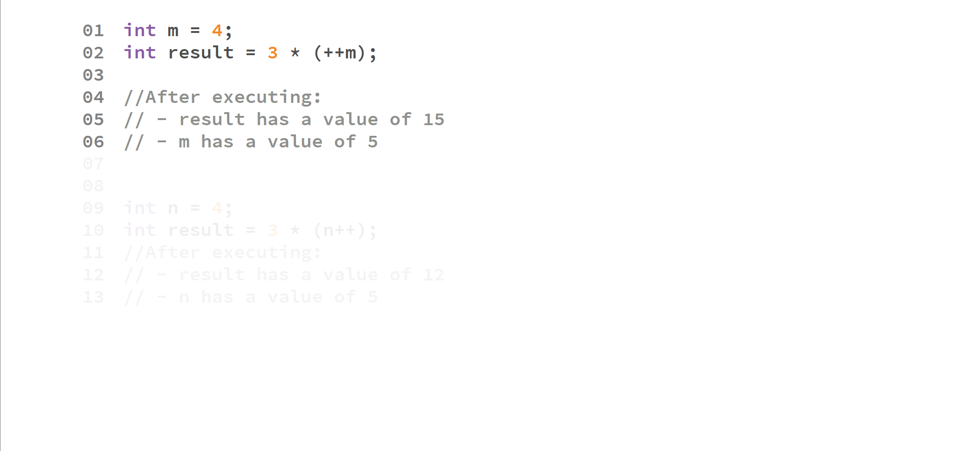

Slide 61
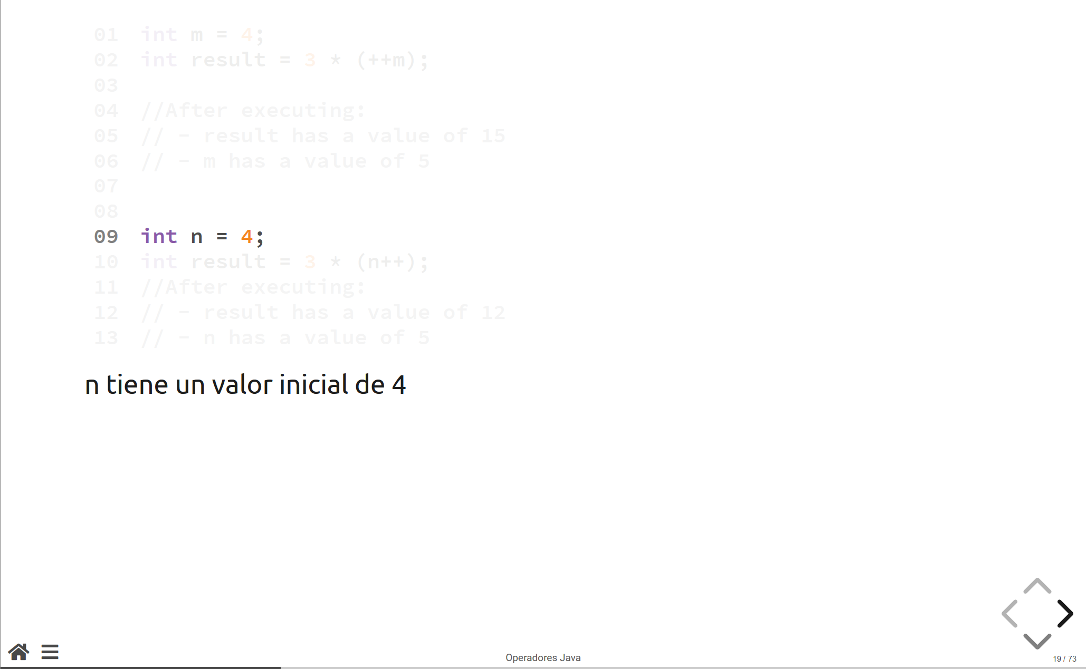

Slide 62
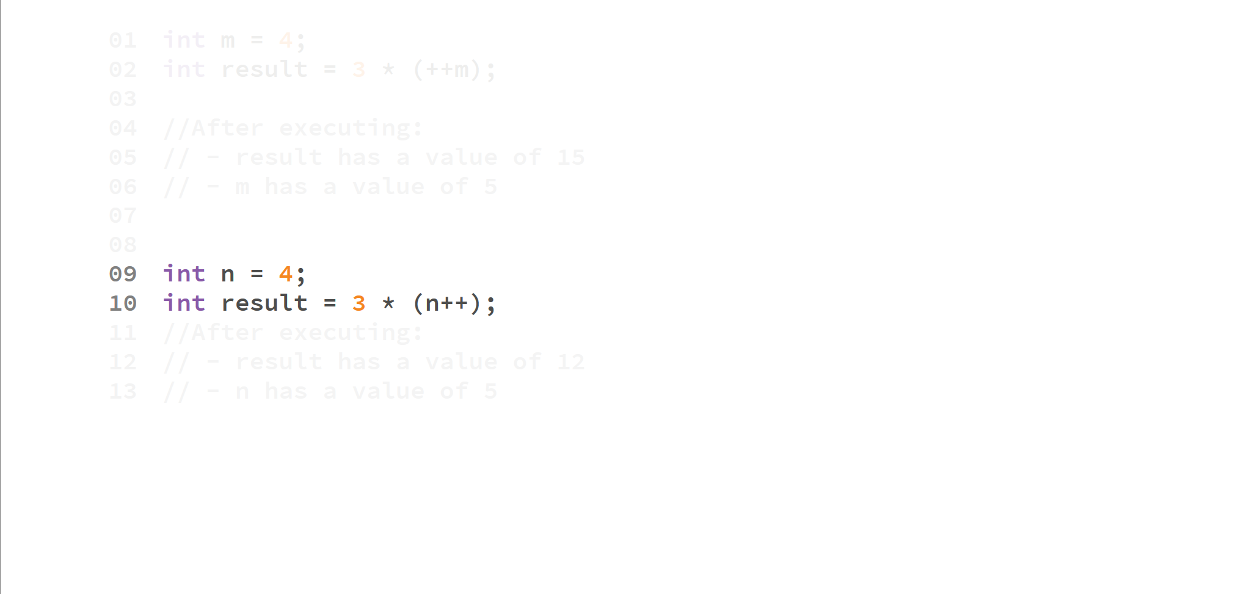

Slide 63
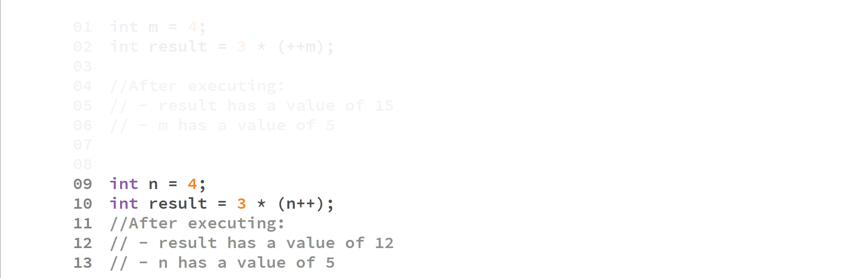

Slide 64
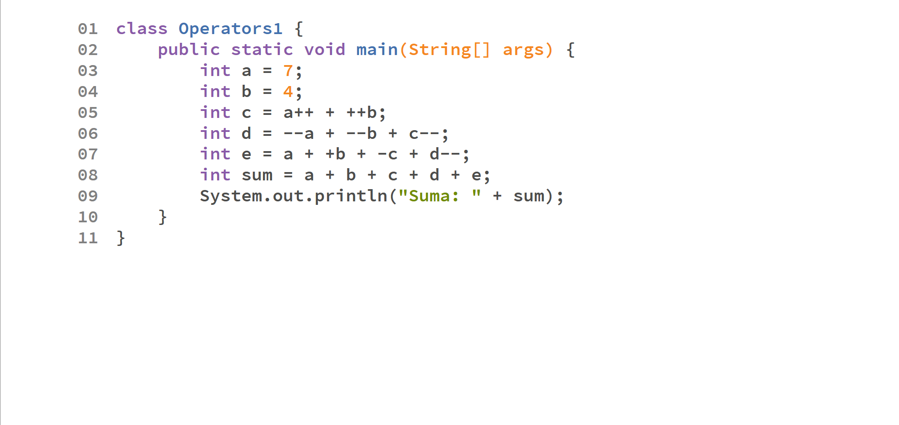

Slide 65
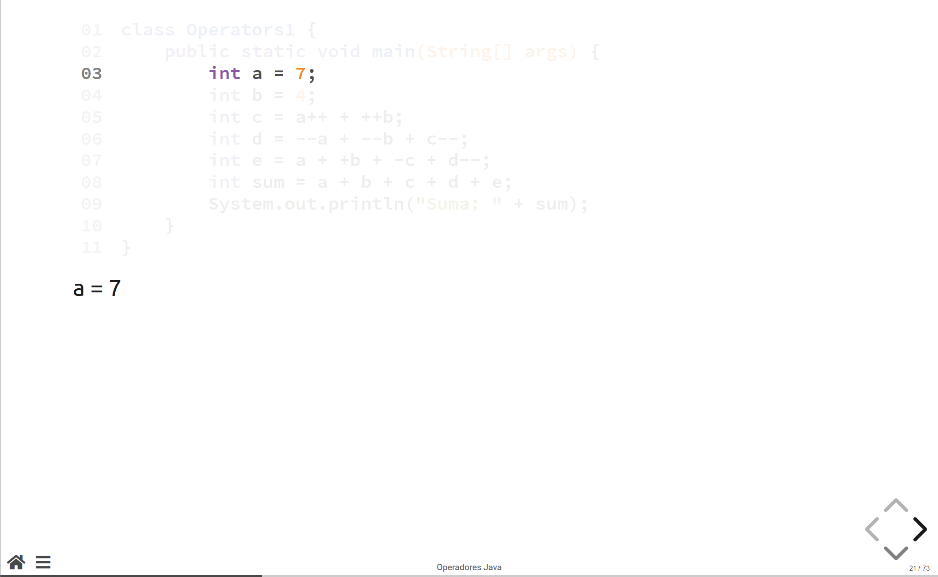

Slide 66
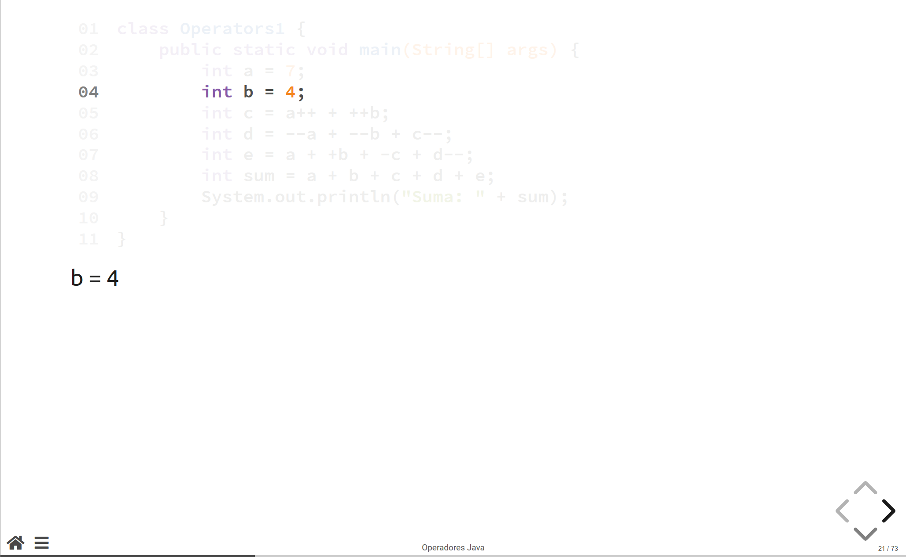

Slide 67
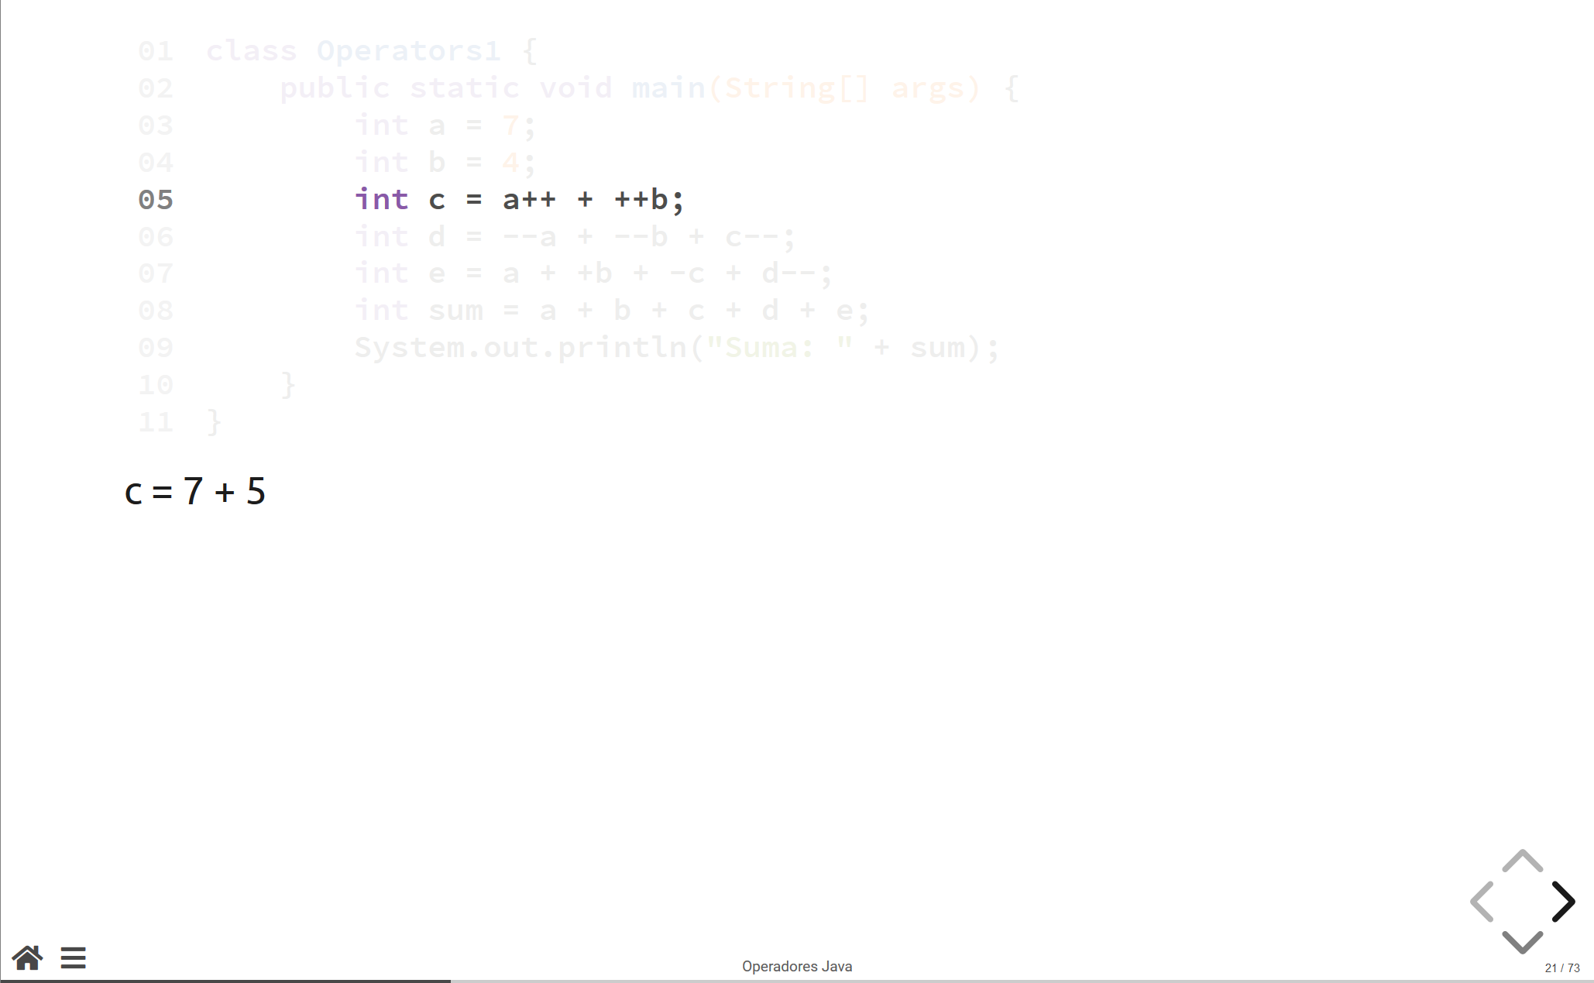

Slide 68
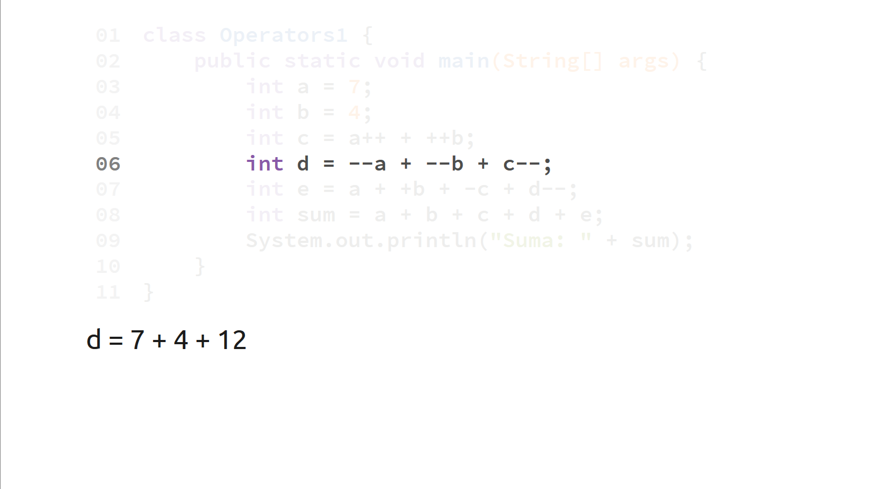

Slide 69
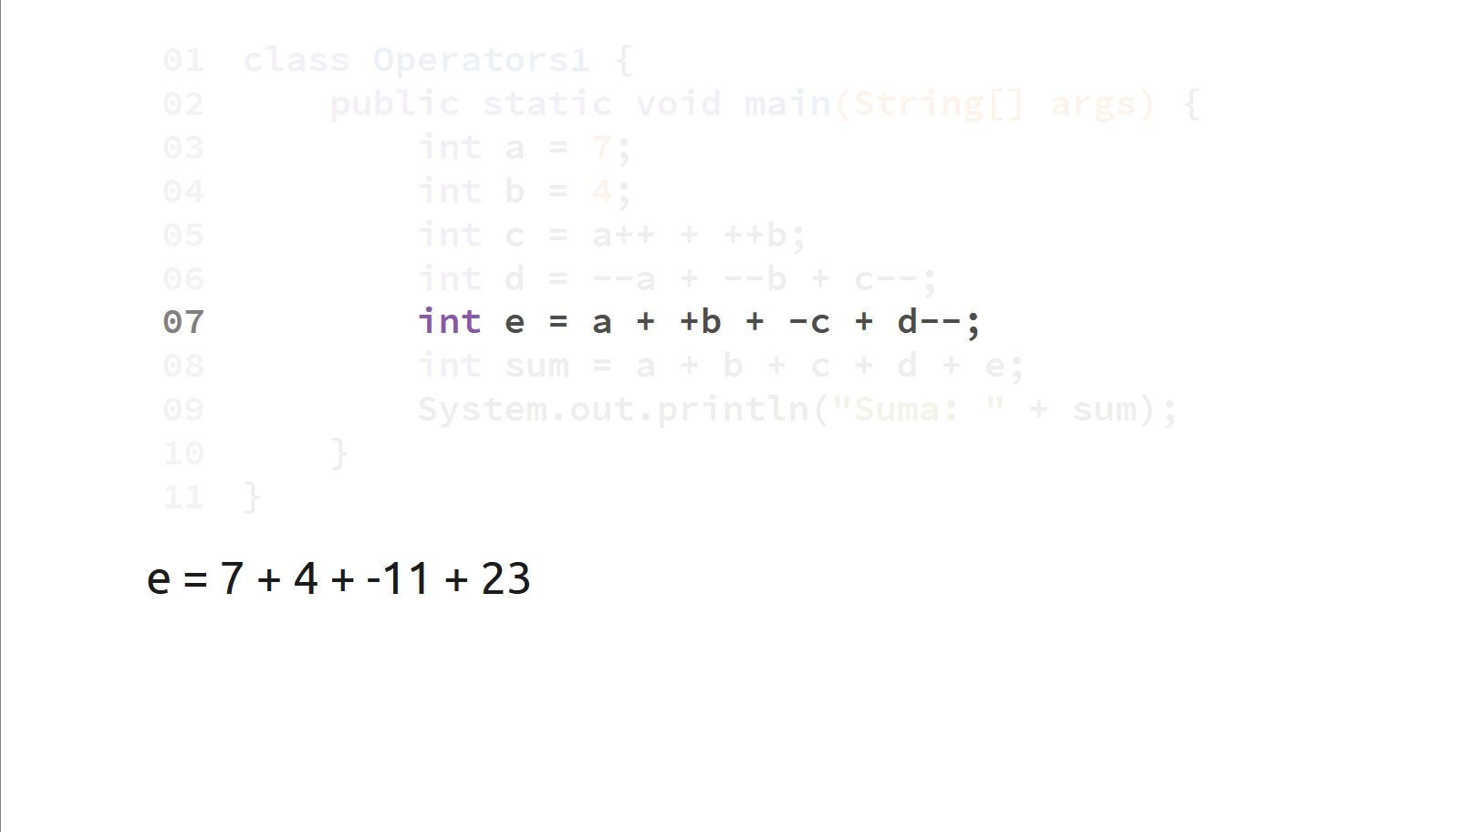

Slide 70
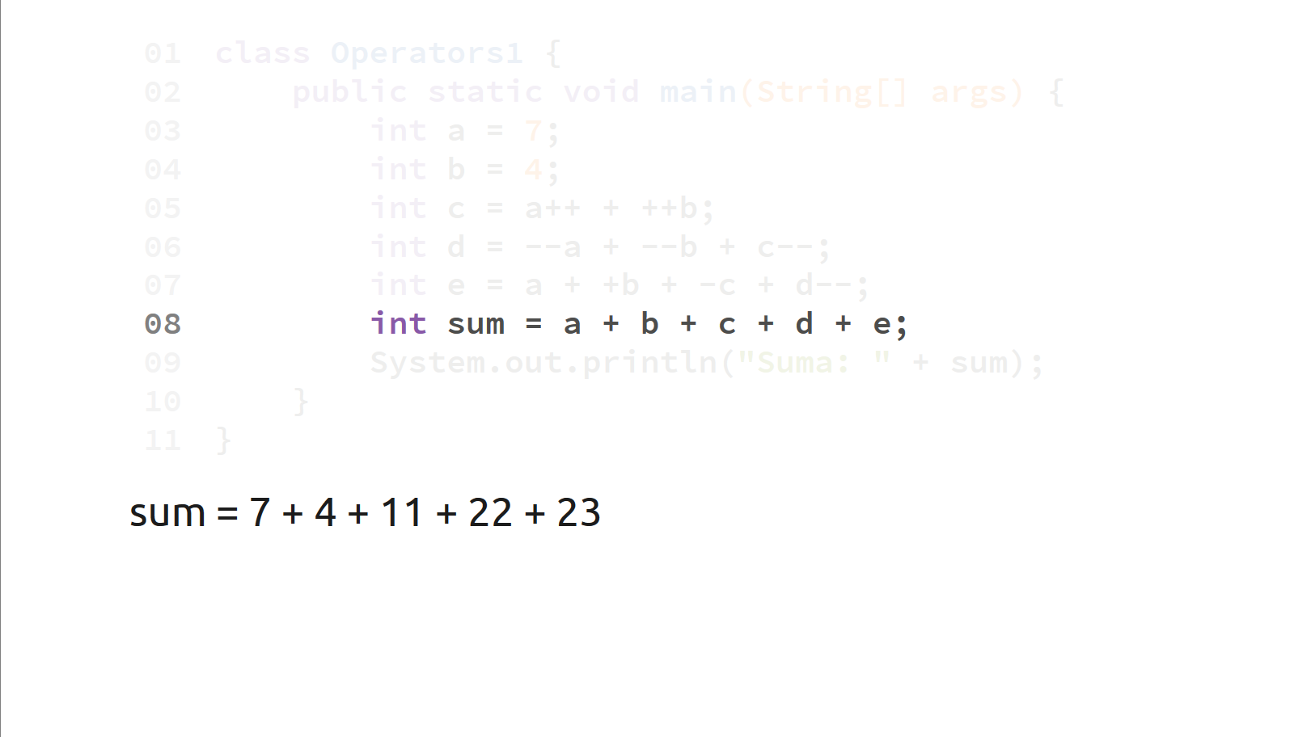

Slide 71
